Slide 1
Module 3: Protocols and Models
Introduction to Networks 7.0 (ITN)
Notes:
Cisco Networking Academy Program
Introduction to Networks v7.0 (ITN)
Module 3: Protocols and Models

Slide 2
Module Objectives
Module Title: Protocols and Models
Module Objective: Explain how network protocols enable devices to access local and remote network resources.
Topic Title | Topic Objective
The Rules | Describe the types of rules that are necessary to successfully communicate.
Protocols | Explain why protocols are necessary in network communication.
Protocol Suites | Explain the purpose of adhering to a protocol suite.
Standards Organizations | Explain the role of standards organizations in establishing protocols for network interoperability.
Reference Models | Explain how the TCP/IP model and the OSI model are used to facilitate standardization in the communication process.
Data Encapsulation | Explain how data encapsulation allows data to be transported across the network.
Data Access | Explain how local hosts access local resources on a network.
Notes:
2
3 – Protocols and Models
3.0 – Introduction
3.0.2 – What will I learn to do in this module?

Slide 3
3.1 The Rules
Notes:
3 – Protocols and Models
3.1 – The Rules

Slide 4
The Rules Communications Fundamentals
Networks can vary in size and complexity. It is not enough to have a connection, devices must agree on “how” to communicate.
There are three elements to any communication:
There will be a source (sender).
There will be a destination (receiver).
There will be a channel (media) that provides for the path of communications to occur.
Notes:
3 – Protocols and Models
3.1 – The Rules
3.1.2 –Communications Fundamentals

Slide 5
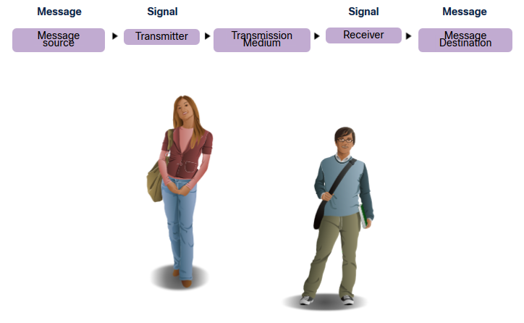
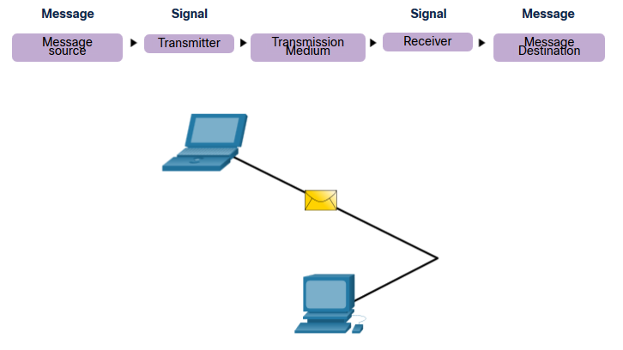
The Rules Communications Protocols
All communications are governed by protocols.
Protocols are the rules that communications will follow.
These rules will vary depending on the protocol.
Notes:
3 – Protocols and Models
3.1 – The Rules
3.1.3 – Communications Protocols

Slide 6
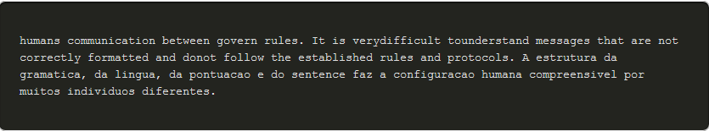

The Rules Rule Establishment
Individuals must use established rules or agreements to govern the conversation.
The first message is difficult to read because it is not formatted properly. The second shows the message properly formatted
Notes:
3 – Protocols and Models
3.1 – The Rules
3.1.4 – Rules Establishment

Slide 7
The Rules Rule Establishment (Cont.)
Protocols must account for the following requirements:
An identified sender and receiver
Common language and grammar
Speed and timing of delivery
Confirmation or acknowledgment requirements
Notes:
3 – Protocols and Models
3.1 – The Rules
3.1.4 – Rules Establishment (Cont.)

Slide 8
The Rules Network Protocol Requirements
Common computer protocols must be in agreement and include the following requirements:
Message encoding
Message formatting and encapsulation
Message size
Message timing
Message delivery options
Notes:
3 – Protocols and Models
3.1 – The Rules
3.1.5 – Network Protocol Requirements

Slide 9
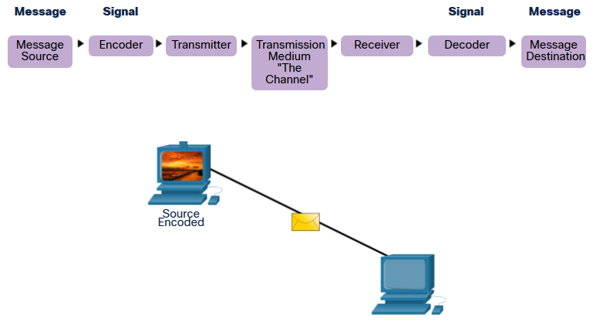
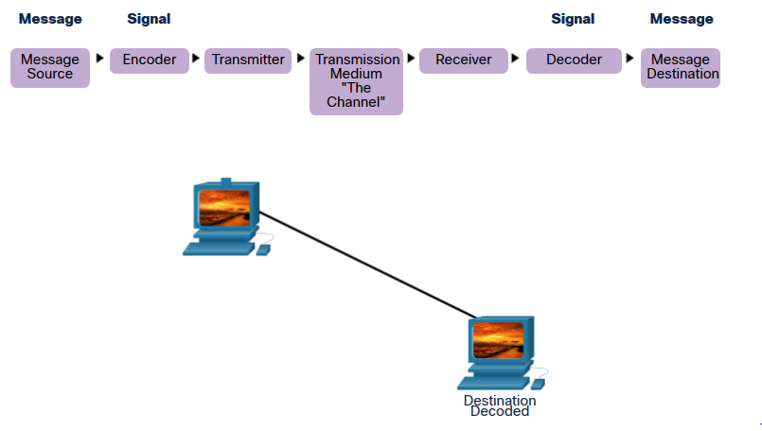
The Rules Message Encoding
Encoding is the process of converting information into another acceptable form for transmission.
Decoding reverses this process to interpret the information.
Notes:
3 – Protocols and Models
3.1 – The Rules
3.1.6 – Message Encoding

Slide 10

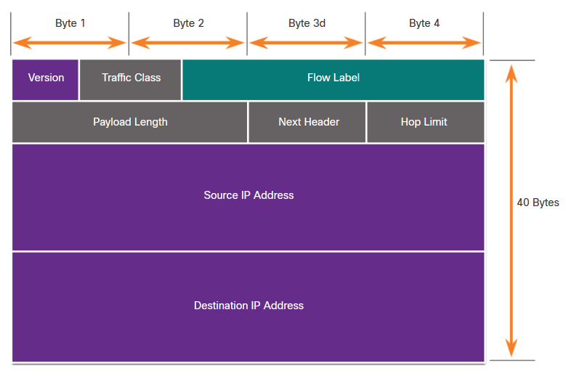
The Rules Message Formatting and Encapsulation
When a message is sent, it must use a specific format or structure.
Message formats depend on the type of message and the channel that is used to deliver the message.
Notes:
3 – Protocols and Models
3.1 – The Rules
3.1.7 – Message Formatting and Encapsulation

Slide 11
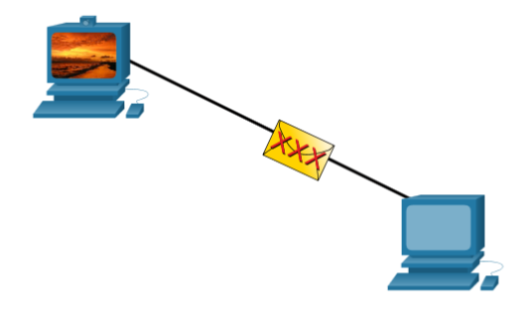
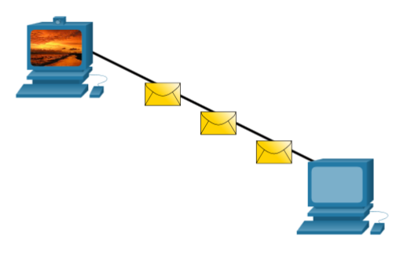
The Rules Message Size
Encoding between hosts must be in an appropriate format for the medium.
Messages sent across the network are converted to bits
The bits are encoded into a pattern of light, sound, or electrical impulses.
The destination host must decode the signals to interpret the message.
Notes:
3 – Protocols and Models
3.1 – The Rules
3.1.8 – Message Size

Slide 12
The Rules Message Timing
Message timing includes the following:
Flow Control – Manages the rate of data transmission and defines how much information can be sent and the speed at which it can be delivered.
Response Timeout – Manages how long a device waits when it does not hear a reply from the destination.
Access method - Determines when someone can send a message.
There may be various rules governing issues like “collisions”. This is when more than one device sends traffic at the same time and the messages become corrupt.
Some protocols are proactive and attempt to prevent collisions; other protocols are reactive and establish a recovery method after the collision occurs.
Notes:
3 – Protocols and Models
3.1 – The Rules
3.1.9 – Message Timing

Slide 13
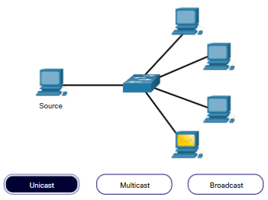
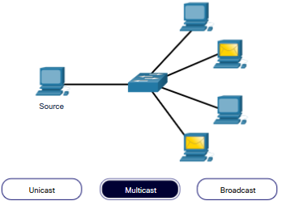
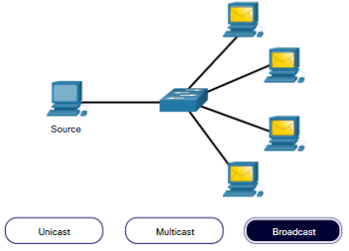
The Rules Message Delivery Options
Message delivery may one of the following methods:
Unicast – one to one communication
Multicast – one to many, typically not all
Broadcast – one to all
Note: Broadcasts are used in IPv4 networks, but are not an option for IPv6. Later we will also see “Anycast” as an additional delivery option for IPv6.
Notes:
3 – Protocols and Models
3.1 – The Rules
3.1.10 – Message Delivery Options

Slide 14
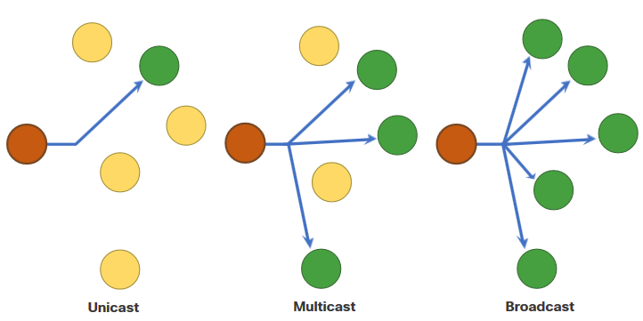
The Rules A Note About the Node Icon
Documents may use the node icon , typically a circle, to represent all devices.
The figure illustrates the use of the node icon for delivery options.
Notes:
3 – Protocols and Models
3.1 – The Rules
3.1.11 – A Note About the Node Icon
3.1.12 – Check Your Understanding – The Rules

Slide 15
3.2 Protocols
Notes:
3 – Protocols and Models
3.2 – Protocols

Slide 16
Protocols Network Protocol Overview
Network protocols define a common set of rules.
Can be implemented on devices in:
Software
Hardware
Both
Protocols have their own:
Function
Format
Rules
Protocol Type | Description
Network Communications | enable two or more devices to communicate over one or more networks
Network Security | secure data to provide authentication, data integrity, and data encryption
Routing | enable routers to exchange route information, compare path information, and select best path
Service Discovery | used for the automatic detection of devices or services
Notes:
3 – Protocols and Models
3.2 – Protocols
3.2.1 – Network Protocol Overview

Slide 17
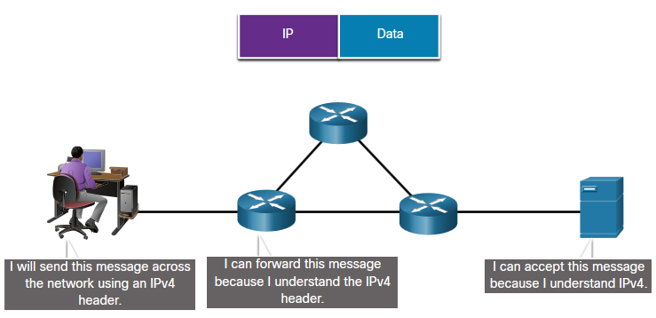
Protocols Network Protocol Functions
Devices use agreed-upon protocols to communicate .
Protocols may have may have one or functions.
Function | Description
Addressing | Identifies sender and receiver
Reliability | Provides guaranteed delivery
Flow Control | Ensures data flows at an efficient rate
Sequencing | Uniquely labels each transmitted segment of data
Error Detection | Determines if data became corrupted during transmission
Application Interface | Process-to-process communications between network applications
Notes:
3 – Protocols and Models
3.2 – Protocols
3.2.2 – Network Protocol Functions

Slide 18
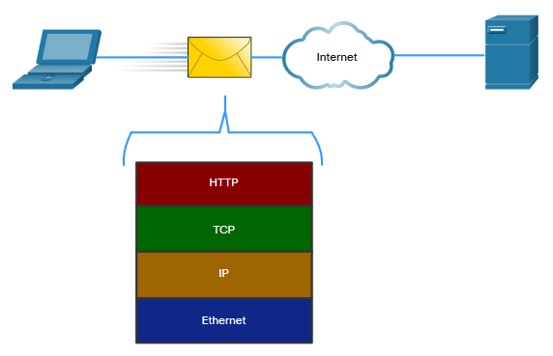
Protocols Protocol Interaction
Networks require the use of several protocols.
Each protocol has its own function and format.
Protocol | Function
Hypertext Transfer Protocol (HTTP) | Governs the way a web server and a web client interact Defines content and format
Transmission Control Protocol (TCP) | Manages the individual conversations Provides guaranteed delivery Manages flow control
Internet Protocol (IP) | Delivers messages globally from the sender to the receiver
Ethernet | Delivers messages from one NIC to another NIC on the same Ethernet Local Area Network (LAN)
Notes:
3 – Protocols and Models
3.2 – Protocols
3.2.3 – Protocol Interaction
3.2.4 – Check Your Understanding - Protocols

Slide 19
3.3 Protocol Suites
Notes:
3 – Protocols and Models
3.3 – Protocol Suites

Slide 20
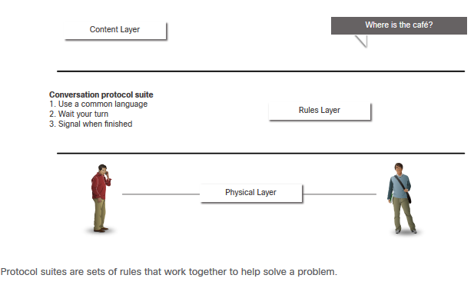
Protocol Suites Network Protocol Suites
Protocols must be able to work with other protocols.
Protocol suite:
A group of inter-related protocols necessary to perform a communication function
Sets of rules that work together to help solve a problem
The protocols are viewed in terms of layers:
Higher Layers
Lower Layers- concerned with moving data and provide services to upper layers
Notes:
3 – Protocols and Models
3.3 – Protocol Suites
3.3.1 – Network Protocol Suites

Slide 21
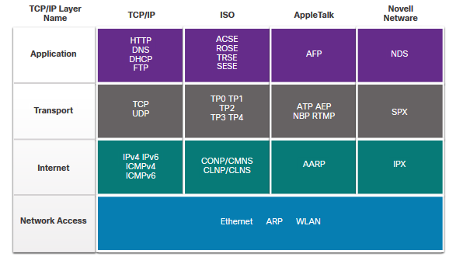
Protocol Suites Evolution of Protocol Suites
There are several protocol suites.
Internet Protocol Suite or TCP/IP- The most common protocol suite and maintained by the Internet Engineering Task Force (IETF)
Open Systems Interconnection (OSI) protocols- Developed by the International Organization for Standardization (ISO) and the International Telecommunications Union (ITU)
AppleTalk- Proprietary suite release by Apple Inc.
Novell NetWare- Proprietary suite developed by Novell Inc.
Notes:
3 – Protocols and Models
3.3 – Protocol Suites
3.3.2 – Evolution of Protocol Suites

Slide 22
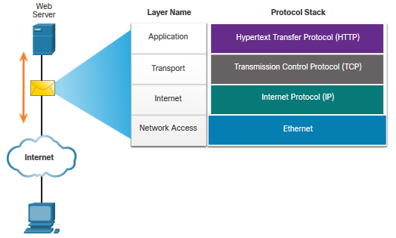
Protocol Suites TCP/IP Protocol Example
TCP/IP protocols operate at the application, transport, and internet layers.
The most common network access layer LAN protocols are Ethernet and WLAN (wireless LAN).
Notes:
3 – Protocols and Models
3.3 – Protocol Suites
3.3.3 – TCP/IP Protocol Example

Slide 23
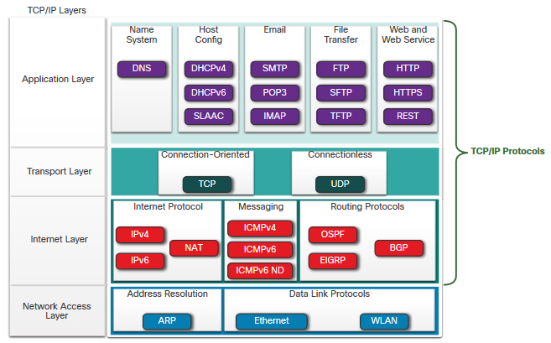
Protocol Suites TCP/IP Protocol Suite
TCP/IP is the protocol suite used by the internet and includes many protocols.
TCP/IP is:
An open standard protocol suite that is freely available to the public and can be used by any vendor
A standards-based protocol suite that is endorsed by the networking industry and approved by a standards organization to ensure interoperability
Notes:
3 – Protocols and Models
3.3 – Protocol Suites
3.3.4 – TCP/IP Protocol Suite

Slide 24
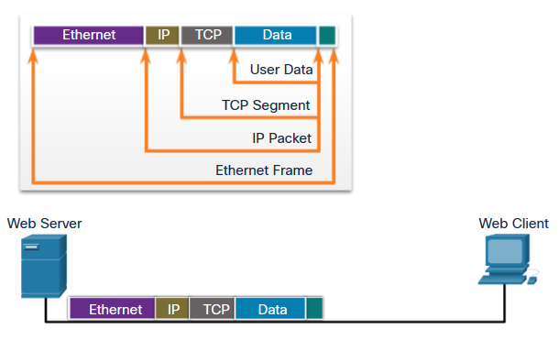
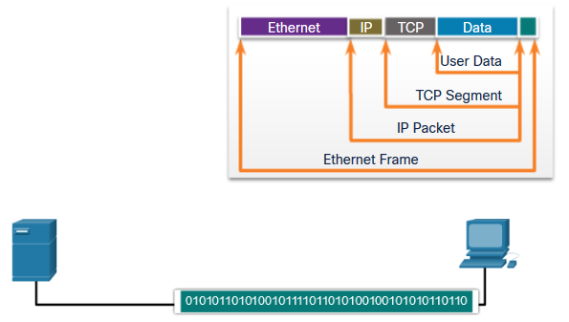
Protocol Suites TCP/IP Communication Process
A web server encapsulating and sending a web page to a client.
A client de-encapsulating the web page for the web browser
Notes:
3 – Protocols and Models
3.3 – Protocol Suites
3.3.5 – TCP/IP Communication Process
3.3.6 – Check Your Understanding – Protocol Suites

Slide 25
Module 9: Address Resolution
Introduction to Networks v7.0 (ITN)
Notes:
Cisco Networking Academy Program
Introduction to Networks v7.0 (ITN)
Module 9: Address Resolution

Slide 26
Module Objectives
Module Title: Address Resolution
Module Objective: Explain how ARP and ND enable communication on a network.
Topic Title | Topic Objective
MAC and IP | Compare the roles of the MAC address and the IP address.
ARP | Describe the purpose of ARP.
Neighbor Discovery | Describe the operation of IPv6 neighbor discovery.
Notes:
26
9 - Address Resolution
9.0.2

Slide 27
9.1 MAC and IP
Notes:
9 - Address Resolution
9.1 MAC and IP

Slide 28
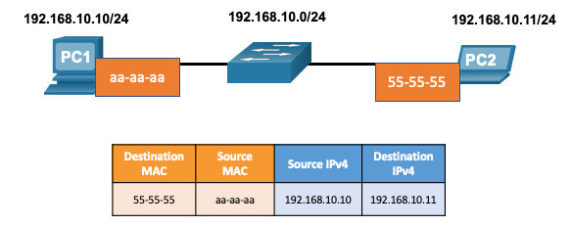
MAC and IP Destination on Same Network
There are two primary addresses assigned to a device on an Ethernet LAN:
Layer 2 physical address (the MAC address) – Used for NIC to NIC communications on the same Ethernet network.
Layer 3 logical address (the IP address) – Used to send the packet from the source device to the destination device.
Layer 2 addresses are used to deliver frames from one NIC to another NIC on the same network. If a destination IP address is on the same network, the destination MAC address will be that of the destination device.
Notes:
9 – Address Resolution
9.1 – MAC and IP
9.1.1 – Destination on Same Network

Slide 29
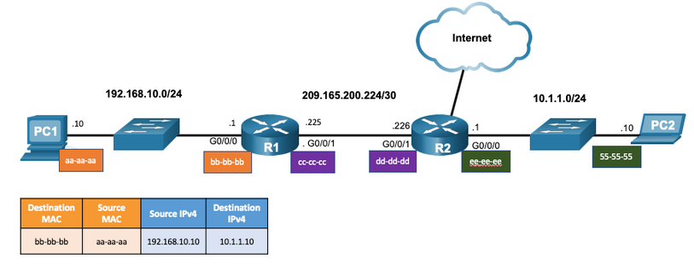
MAC and IP Destination on Remote Network
When the destination IP address is on a remote network, the destination MAC address is that of the default gateway.
ARP is used by IPv4 to associate the IPv4 address of a device with the MAC address of the device NIC.
ICMPv6 is used by IPv6 to associate the IPv6 address of a device with the MAC address of the device NIC.
Notes:
9 – Address Resolution
9.1 – MAC and IP
9.1.2 – Destination on Remote Network

Slide 30
9.2 ARP
Notes:
9 - Address Resolution
9.2 ARP

Slide 31
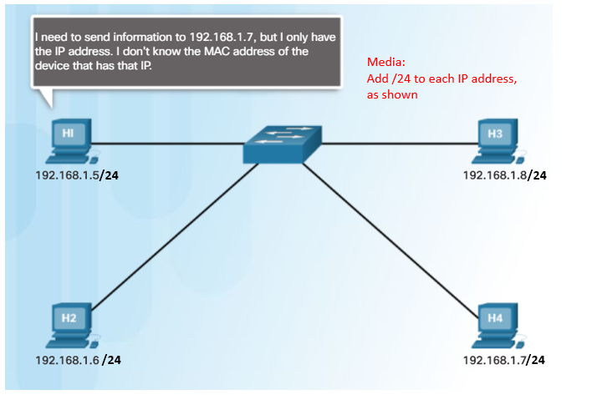
ARP ARP Overview
A device uses ARP to determine the destination MAC address of a local device when it knows its IPv4 address.
ARP provides two basic functions:
Resolving IPv4 addresses to MAC addresses
Maintaining an ARP table of IPv4 to MAC address mappings
Notes:
9 – Address Resolution
9.2 – ARP
9.2.1 – ARP Overview

Slide 32
ARP ARP Functions
To send a frame, a device will search its ARP table for a destination IPv4 address and a corresponding MAC address.
If the packet’s destination IPv4 address is on the same network, the device will search the ARP table for the destination IPv4 address.
If the destination IPv4 address is on a different network, the device will search the ARP table for the IPv4 address of the default gateway.
If the device locates the IPv4 address, its corresponding MAC address is used as the destination MAC address in the frame.
If there is no ARP table entry is found, then the device sends an ARP request.
Notes:
9 – Address Resolution
9.2 – ARP
9.2.2 – ARP Functions

Slide 33
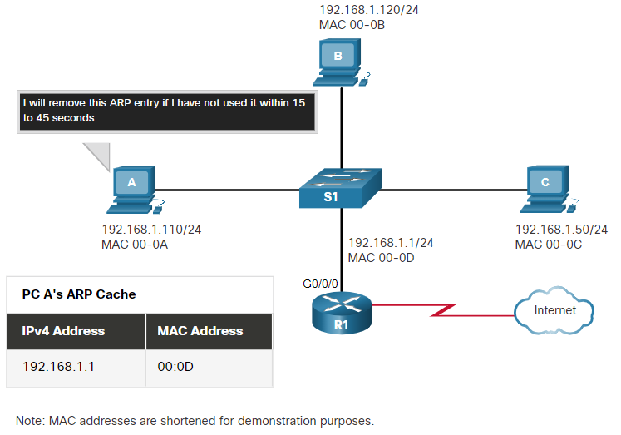
ARP Removing Entries from an ARP Table
Entries in the ARP table are not permanent and are removed when an ARP cache timer expires after a specified period of time.
The duration of the ARP cache timer differs depending on the operating system.
ARP table entries can also be removed manually by the administrator.
Notes:
9 – Address Resolution
9.2 – ARP
9.2.6– Removing Entries from an ARP Table

Slide 34
ARP ARP Tables on Networking Devices
The show ip arp command displays the ARP table on a Cisco router.
The arp –a command displays the ARP table on a Windows 10 PC.
R1# show ip arp
Protocol Address Age (min) Hardware Addr Type Interface
Internet 192.168.10.1 - a0e0.af0d.e140 ARPA GigabitEthernet0/0/0
C:\Users\PC> arp -a
Interface: 192.168.1.124 --- 0x10
Internet Address Physical Address Type
192.168.1.1 c8-d7-19-cc-a0-86 dynamic
192.168.1.101 08-3e-0c-f5-f7-77 dynamic
Notes:
9 – Address Resolution
9.2 – ARP
9.2.7 – ARP Tables on Networking Devices

Slide 35
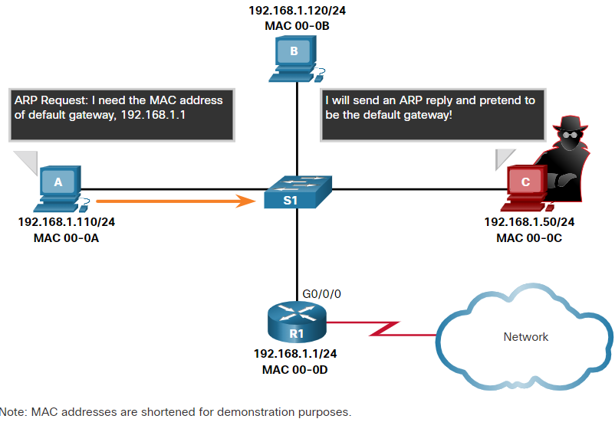
ARP ARP Issues – ARP Broadcasting and ARP Spoofing
ARP requests are received and processed by every device on the local network.
Excessive ARP broadcasts can cause some reduction in performance.
ARP replies can be spoofed by a threat actor to perform an ARP poisoning attack.
Enterprise level switches include mitigation techniques to protect against ARP attacks.
Notes:
9 – Address Resolution
9.2 – ARP
9.2.8 – ARP Issues – ARP Broadcast and ARP Spoofing

Slide 36
Module 14: Transport Layer
Introduction to Networks v7.0 (ITN)

Slide 37
Module Objectives
Module Title: Transport Layer
Module Objective: Compare the operations of transport layer protocols in supporting end-to-end communication.
Topic Title | Topic Objective
Transportation of Data | Explain the purpose of the transport layer in managing the transportation of data in end-to-end communication.
TCP Overview | Explain characteristics of TCP.
UDP Overview | Explain characteristics of UDP.
Port Numbers | Explain how TCP and UDP use port numbers.
TCP Communication Process | Explain how TCP session establishment and termination processes facilitate reliable communication.
Reliability and Flow Control | Explain how TCP protocol data units are transmitted and acknowledged to guarantee delivery.
UDP Communication | Compare the operations of transport layer protocols in supporting end-to-end communication.
Notes:
37
14- Transport Layer
14.0.2 – What will I learn to do in this module?

Slide 38
14.1 Transportation of Data
Notes:
14 –Transport Layer
14.1 - Transportation of Data

Slide 39
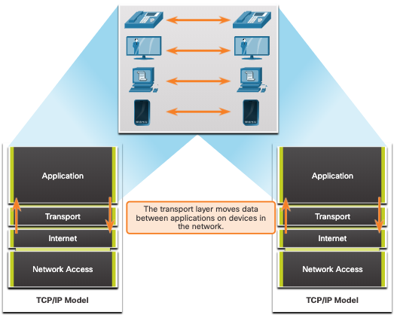
Transportation of Data Role of the Transport Layer
The transport layer is:
responsible for logical communications between applications running on different hosts.
The link between the application layer and the lower layers that are responsible for network transmission.
Notes:
14 –Transport Layer
14.1 - Transportation of Data
14.1.1 – Role of the Transport Layer

Slide 40
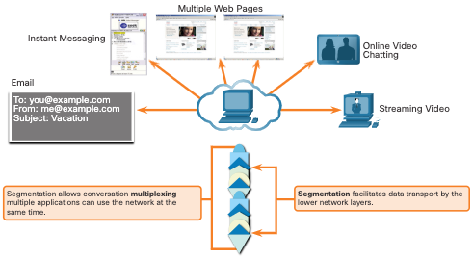
Transportation of Data Transport Layer Responsibilities
The transport layer has the following responsibilities:
Tracking individual conversations
Segmenting data and reassembling segments
Adds header information
Identify, separate, and manage multiple conversations
Uses segmentation and multiplexing to enable different communication conversations to be interleaved on the same network
Notes:
14 –Transport Layer
14.1 - Transportation of Data
14.1.2 – Transport Layer Responsibilities

Slide 41
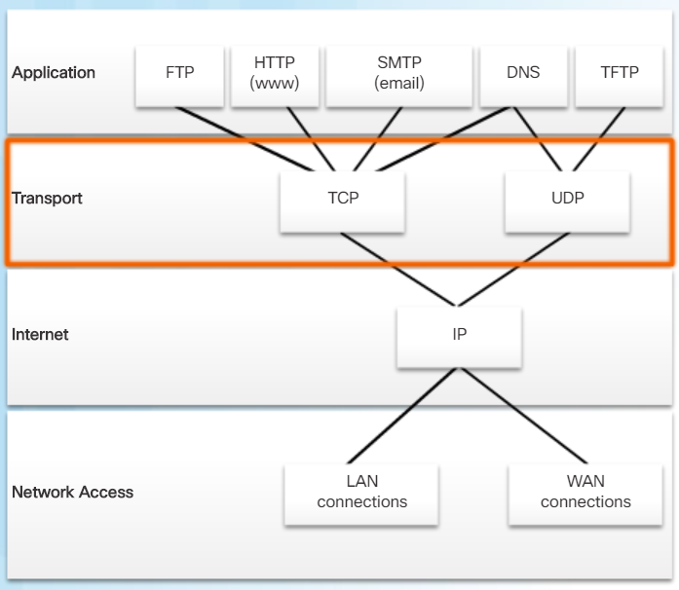
Transportation of Data Transport Layer Protocols
IP does not specify how the delivery or transportation of the packets takes place.
Transport layer protocols specify how to transfer messages between hosts, and are responsible for managing reliability requirements of a conversation.
The transport layer includes the TCP and UDP protocols.
Notes:
14 –Transport Layer
14.1 - Transportation of Data
14.1.3 – Transport Layer Protocols

Slide 42
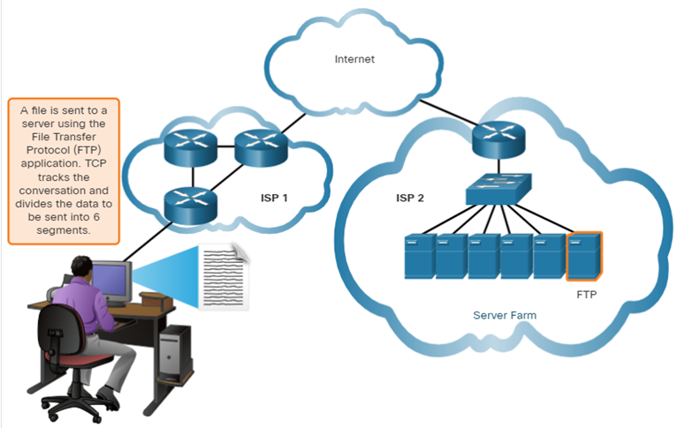
Transportation of Data Transmission Control Protocol
TCP provides reliability and flow control. TCP basic operations:
Number and track data segments transmitted to a specific host from a specific application
Acknowledge received data
Retransmit any unacknowledged data after a certain amount of time
Sequence data that might arrive in wrong order
Send data at an efficient rate that is acceptable by the receiver
Notes:
14 –Transport Layer
14.1 - Transportation of Data
14.1.4 – Transmission Control Protocol (TCP)

Slide 43
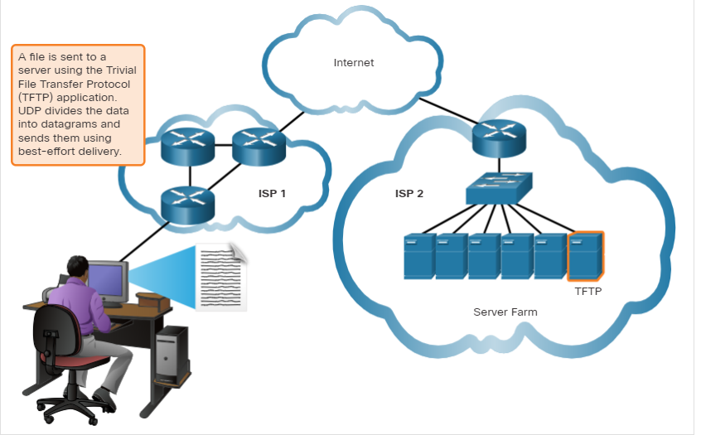
Transportation of Data User Datagram Protocol (UDP)
UDP provides the basic functions for delivering datagrams between the appropriate applications, with very little overhead and data checking.
UDP is a connectionless protocol.
UDP is known as a best-effort delivery protocol because there is no acknowledgment that the data is received at the destination.
Notes:
14 –Transport Layer
14.1 - Transportation of Data
14.1.5 – User Datagram Protocol (UDP)

Slide 44
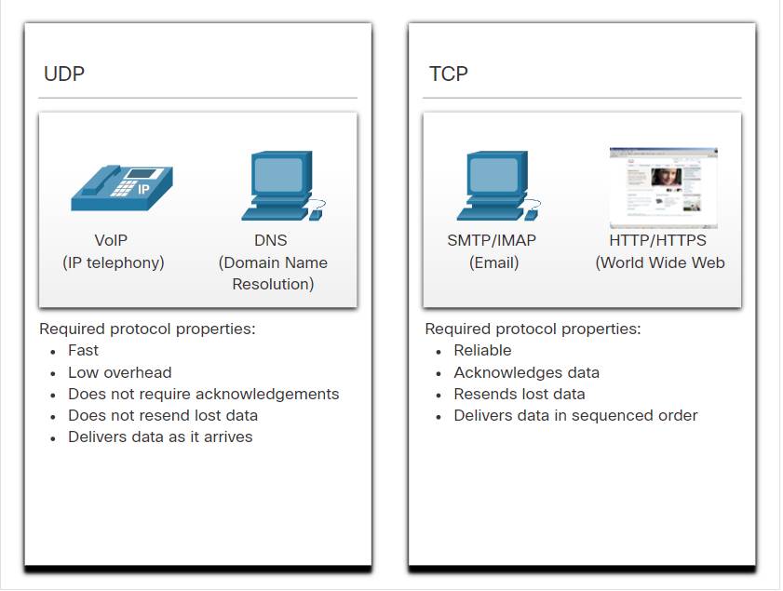
Transportation of Data The Right Transport Layer Protocol for the Right Application
UDP is also used by request-and-reply applications where the data is minimal, and retransmission can be done quickly.
If it is important that all the data arrives and that it can be processed in its proper sequence, TCP is used as the transport protocol.
Notes:
14 –Transport Layer
14.1 - Transportation of Data
14.1.6 – The Right Transport Layer Protocol for the Right Application
14.1.7 – Check your Understanding- Transportation of Data

Slide 45
14.2 TCP Overview
Notes:
14 – Transport Layer
14.2 – TCP Overview

Slide 46
TCP Overview TCP Features
Establishes a Session - TCP is a connection-oriented protocol that negotiates and establishes a permanent connection (or session) between source and destination devices prior to forwarding any traffic.
Ensures Reliable Delivery - For many reasons, it is possible for a segment to become corrupted or lost completely, as it is transmitted over the network. TCP ensures that each segment that is sent by the source arrives at the destination.
Provides Same-Order Delivery - Because networks may provide multiple routes that can have different transmission rates, data can arrive in the wrong order.
Supports Flow Control - Network hosts have limited resources (i.e., memory and processing power). When TCP is aware that these resources are overtaxed, it can request that the sending application reduce the rate of data flow.
Notes:
14 – Transport Layer
14.2 – TCP Overview
14.2.1 – TCP Features

Slide 47
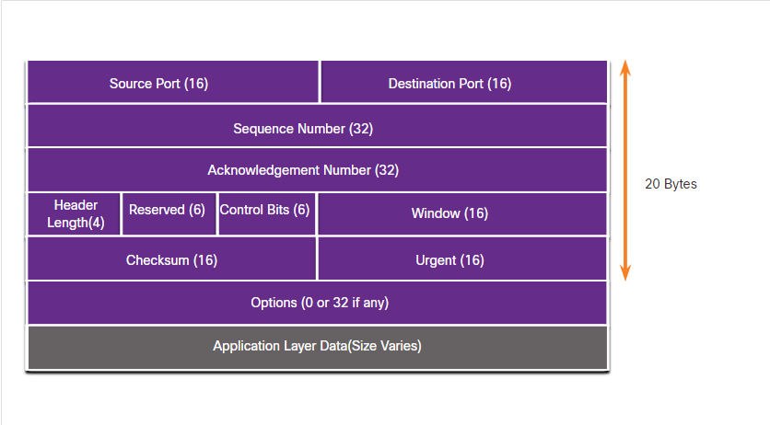
TCP Overview TCP Header
TCP is a stateful protocol which means it keeps track of the state of the communication session.
TCP records which information it has sent, and which information has been acknowledged.
Notes:
14 – Transport Layer
14.2 – TCP Overview
14.2.2 – TCP Header

Slide 48
TCP Overview TCP Header Fields
TCP Header Field | Description
Source Port | A 16-bit field used to identify the source application by port number.
Destination Port | A 16-bit field used to identify the destination application by port number.
Sequence Number | A 32-bit field used for data reassembly purposes.
Acknowledgment Number | A 32-bit field used to indicate that data has been received and the next byte expected from the source.
Header Length | A 4-bit field known as ʺdata offsetʺ that indicates the length of the TCP segment header.
Reserved | A 6-bit field that is reserved for future use.
Control bits | A 6-bit field used that includes bit codes, or flags, which indicate the purpose and function of the TCP segment.
Window size | A 16-bit field used to indicate the number of bytes that can be accepted at one time.
Checksum | A 16-bit field used for error checking of the segment header and data.
Urgent | A 16-bit field used to indicate if the contained data is urgent.
Notes:
14 – Transport Layer
14.2 – TCP Overview
14.2.3 – TCP Header

Slide 49
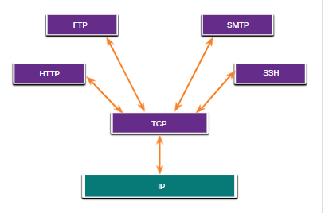
TCP Overview Applications that use TCP
TCP handles all tasks associated with dividing the data stream into segments, providing reliability, controlling data flow, and reordering segments.
Notes:
14 – Transport Layer
14.2 – TCP Overview
14.2.4 – Applications that use TCP
14.2.5 Check your Understanding – TCP Overview

Slide 50
14.3 UDP Overview
Notes:
14 – Transport Layer
14.3 – UDP Overview

Slide 51
UDP Overview UDP Features
UDP features include the following:
Data is reconstructed in the order that it is received.
Any segments that are lost are not resent.
There is no session establishment.
The sending is not informed about resource availability.
Notes:
14 – Transport Layer
14.3 – UDP Overview
14.3.1 – UDP Features

Slide 52
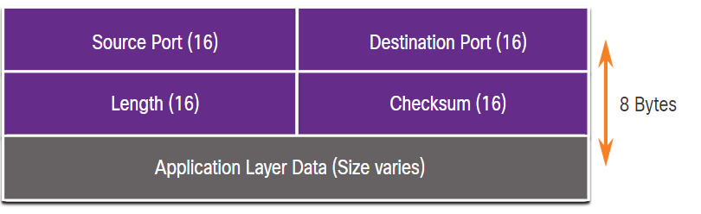
UDP Overview UDP Header
The UDP header is far simpler than the TCP header because it only has four fields and requires 8 bytes (i.e. 64 bits).
Notes:
14 – Transport Layer
14.3 – UDP Overview
14.3.2 – UDP Header

Slide 53
UDP Overview UDP Header Fields
The table identifies and describes the four fields in a UDP header.
UDP Header Field | Description
Source Port | A 16-bit field used to identify the source application by port number.
Destination Port | A 16-bit field used to identify the destination application by port number.
Length | A 16-bit field that indicates the length of the UDP datagram header.
Checksum | A 16-bit field used for error checking of the datagram header and data.
Notes:
14 – Transport Layer
14.3 – UDP Overview
14.3.3 - UDP Header Fields

Slide 54
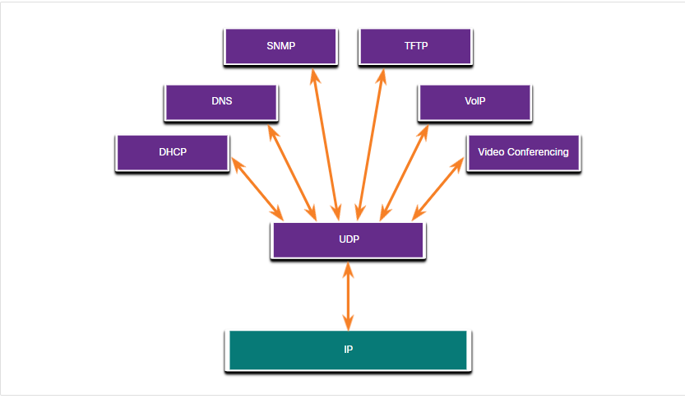
UDP Overview Applications that use UDP
Live video and multimedia applications - These applications can tolerate some data loss but require little or no delay. Examples include VoIP and live streaming video.
Simple request and reply applications - Applications with simple transactions where a host sends a request and may or may not receive a reply. Examples include DNS and DHCP.
Applications that handle reliability themselves - Unidirectional communications where flow control, error detection, acknowledgments, and error recovery is not required, or can be handled by the application. Examples include SNMP and TFTP.
Notes:
14 – Transport Layer
14.3 – UDP Overview
14.3.4 – Applications that use UDP
14.3.5 - Check Your Understanding – UDP Overview

Slide 55
14.4 Port Numbers
Notes:
14 – Transport Layer
14.4 – Port Numbers

Slide 56

Port Numbers Multiple Separate Communications
TCP and UDP transport layer protocols use port numbers to manage multiple, simultaneous conversations.
The source port number is associated with the originating application on the local host whereas the destination port number is associated with the destination application on the remote host.
Notes:
14 – Transport Layer
14.4 – Port Numbers
14.4.1 - Multiple Separate Communications

Slide 57
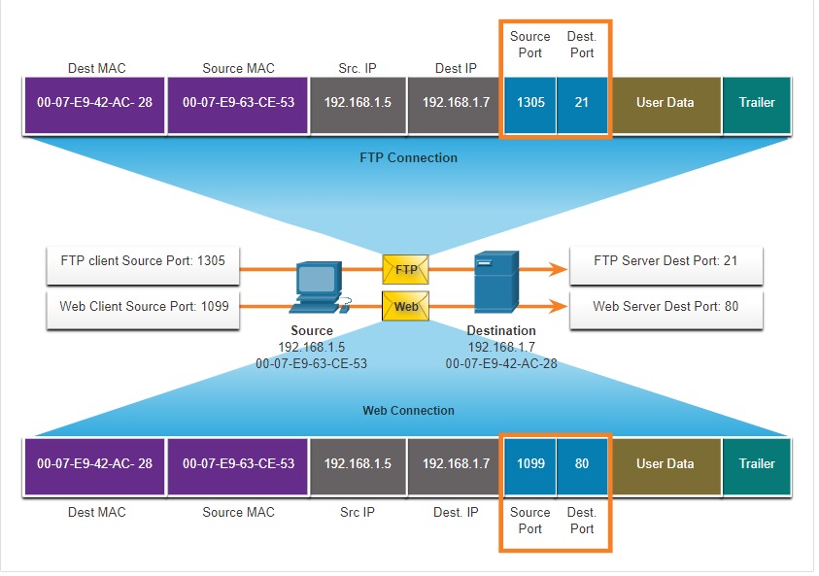
Port numbers Socket Pairs
The source and destination ports are placed within the segment.
The segments are then encapsulated within an IP packet.
The combination of the source IP address and source port number, or the destination IP address and destination port number is known as a socket.
Sockets enable multiple processes, running on a client, to distinguish themselves from each other, and multiple connections to a server process to be distinguished from each other.
Notes:
14 – Transport Layer
14.4 – Port Numbers
14.4.2 – Socket Pairs

Slide 58
Port Numbers Port Number Groups
Port Group | Number Range | Description
Well-known Ports | 0 to 1,023 | These port numbers are reserved for common or popular services and applications such as web browsers, email clients, and remote access clients. Defined well-known ports for common server applications enables clients to easily identify the associated service required.
Registered Ports | 1,024 to 49,151 | These port numbers are assigned by IANA to a requesting entity to use with specific processes or applications. These processes are primarily individual applications that a user has chosen to install, rather than common applications that would receive a well-known port number. For example, Cisco has registered port 1812 for its RADIUS server authentication process.
Private and/or Dynamic Ports | 49,152 to 65,535 | These ports are also known as ephemeral ports. The client’s OS usually assign port numbers dynamically when a connection to a service is initiated. The dynamic port is then used to identify the client application during communication.
Notes:
14 – Transport Layer
14.4 – Port Numbers
14.4.3 - Port Number Groups

Slide 59
Port Numbers Port Number Groups (Cont.)
Well-Known Port Numbers
Port Number | Protocol | Application
20 | TCP | File Transfer Protocol (FTP) - Data
21 | TCP | File Transfer Protocol (FTP) - Control
22 | TCP | Secure Shell (SSH)
23 | TCP | Telnet
25 | TCP | Simple Mail Transfer Protocol (SMTP)
53 | UDP, TCP | Domain Name Service (DNS)
67 | UDP | Dynamic Host Configuration Protocol (DHCP) - Server
68 | UDP | Dynamic Host Configuration Protocol - Client
69 | UDP | Trivial File Transfer Protocol (TFTP)
80 | TCP | Hypertext Transfer Protocol (HTTP)
110 | TCP | Post Office Protocol version 3 (POP3)
143 | TCP | Internet Message Access Protocol (IMAP)
161 | UDP | Simple Network Management Protocol (SNMP)
443 | TCP | Hypertext Transfer Protocol Secure (HTTPS)
Notes:
14 – Transport Layer
14.4 – Port Numbers
14.4.3 - Port Number Groups (Cont.)

Slide 60
Port Numbers The netstat Command
Unexplained TCP connections can pose a major security threat. Netstat is an important tool to verify connections.
C:\> netstat
Active Connections
Proto Local Address Foreign Address State
TCP 192.168.1.124:3126 192.168.0.2:netbios-ssn ESTABLISHED
TCP 192.168.1.124:3158 207.138.126.152:http ESTABLISHED
TCP 192.168.1.124:3159 207.138.126.169:http ESTABLISHED
TCP 192.168.1.124:3160 207.138.126.169:http ESTABLISHED
TCP 192.168.1.124:3161 sc.msn.com:http ESTABLISHED
TCP 192.168.1.124:3166 www.cisco.com:http ESTABLISHED
Notes:
14 – Transport Layer
14.4 – Port Numbers
14.4.4 - The netstat Command
14.4.5 – Check Your Understanding – Port Numbers

Slide 61
14.5 TCP Communication Process
Notes:
14 – Transport Layer
14.5 – TCP Communication Process

Slide 62
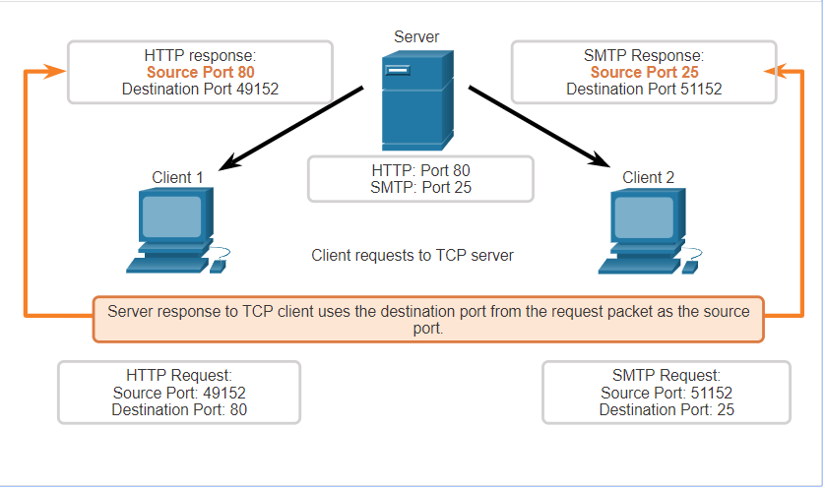
TCP Communication Process TCP Server Processes
Each application process running on a server is configured to use a port number.
An individual server cannot have two services assigned to the same port number within the same transport layer services.
An active server application assigned to a specific port is considered open, which means that the transport layer accepts, and processes segments addressed to that port.
Any incoming client request addressed to the correct socket is accepted, and the data is passed to the server application.
Notes:
14 – Transport Layer
14.5 – TCP Communication Process
14.5.1 – TCP Server Processes

Slide 63
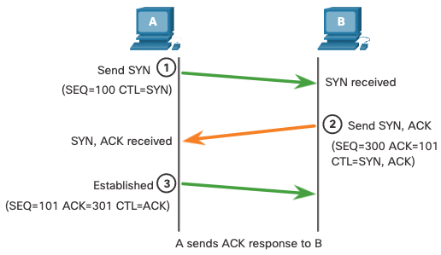
TCP Communication Process TCP Connection Establishment
Step 1: The initiating client requests a client-to-server communication session with the server.
Step 2: The server acknowledges the client-to-server communication session and requests a server-to-client communication session.
Step 3: The initiating client acknowledges the server-to-client communication session.
Notes:
14 – Transport Layer
14.5 – TCP Communication Process
14.5.2 – TCP Connection Establishment

Slide 64
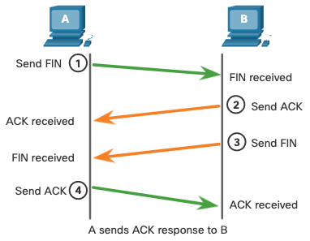
TCP Communication Process Session Termination
Step 1: When the client has no more data to send in the stream, it sends a segment with the FIN flag set.
Step 2: The server sends an ACK to acknowledge the receipt of the FIN to terminate the session from client to server.
Step 3: The server sends a FIN to the client to terminate the server-to-client session.
Step 4: The client responds with an ACK to acknowledge the FIN from the server.
Notes:
14 – Transport Layer
14.5 – TCP Communication Process
14.5.3 – Session Termination

Slide 65
TCP Communication Process TCP Three-Way Handshake Analysis
Functions of the Three-Way Handshake:
It establishes that the destination device is present on the network.
It verifies that the destination device has an active service and is accepting requests on the destination port number that the initiating client intends to use.
It informs the destination device that the source client intends to establish a communication session on that port number.
After the communication is completed the sessions are closed, and the connection is terminated. The connection and session mechanisms enable TCP reliability function.
Notes:
14 – Transport Layer
14.5 – TCP Communication Process
14.5.4 – Three-way Handshake Establishment

Slide 66
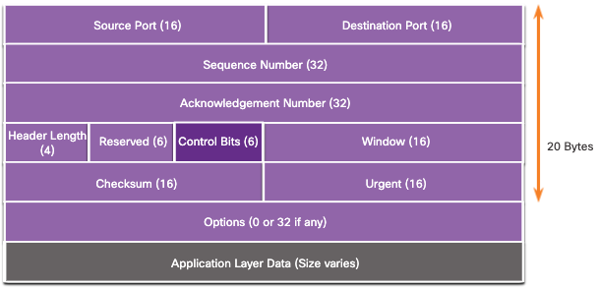
TCP Communication Process TCP Three-Way Handshake Analysis (Cont.)
The six control bit flags are as follows:
URG - Urgent pointer field significant
ACK - Acknowledgment flag used in connection establishment and session termination
PSH - Push function
RST - Reset the connection when an error or timeout occurs
SYN - Synchronize sequence numbers used in connection establishment
FIN - No more data from sender and used in session termination
Notes:
14 – Transport Layer
14.5 – TCP Communication Process
14.5.4 – Three-way Handshake Analysis

Slide 67
Module 8: Network Layer
Introduction to Networks v7.0 (ITN)
Notes:
Cisco Networking Academy Program
Introduction to Networks v7.0 (ITN)
Module 8: Network Layer

Slide 68
Module 8: Topics
What will I learn to do in this module?
Topic Title | Topic Objective
Network Layer Characteristics | Explain how the network layer uses IP protocols for reliable communications.
IPv4 Packet | Explain the role of the major header fields in the IPv4 packet.
IPv6 Packet | Explain the role of the major header fields in the IPv6 packet.
How a Host Routes | Explain how network devices use routing tables to direct packets to a destination network.
Router Routing Tables | Explain the function of fields in the routing table of a router.
Notes:
68
8 – Network Layer
8.0 – Introduction
8.0.2 – What will I learn to do in this module?

Slide 69
8.1 Network Layer Characteristics
Notes:
8 – Network Layer
8.1 – Network Layer Characteristics

Slide 70
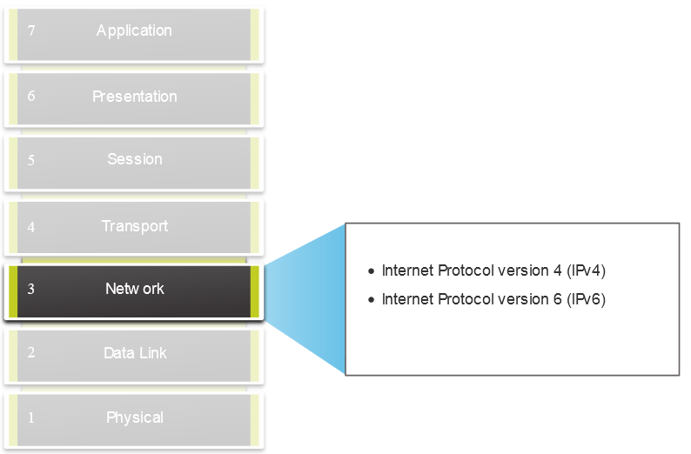
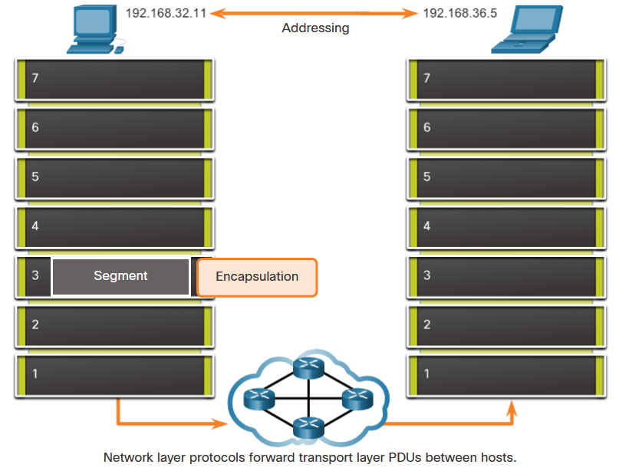
Network Layer Characteristics The Network Layer
Provides services to allow end devices to exchange data
IP version 4 (IPv4) and IP version 6 (IPv6) are the principle network layer communication protocols.
The network layer performs four basic operations:
Addressing end devices
Encapsulation
Routing
De-encapsulation
Notes:
8 – Network Layer
8.1 – Network Layer Characteristics
8.1.1 – The Network Layer

Slide 71
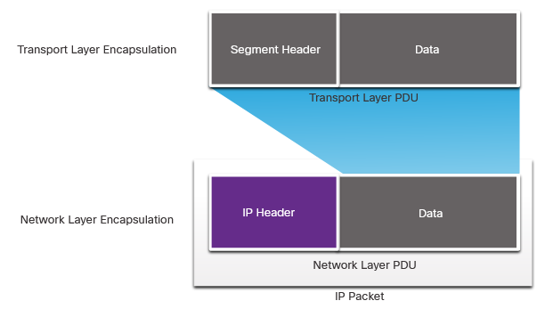
Network Layer Characteristics IP Encapsulation
IP encapsulates the transport layer segment.
IP can use either an IPv4 or IPv6 packet and not impact the layer 4 segment.
IP packet will be examined by all layer 3 devices as it traverses the network.
The IP addressing does not change from source to destination.
Note: NAT will change addressing, but will be discussed in a later module.
Notes:
8 – Network Layer
8.1 – Network Layer Characteristics
8.1.2 – IP Encapsulation

Slide 72
Network Layer Characteristics Characteristics of IP
IP is meant to have low overhead and may be described as:
Connectionless
Best Effort
Media Independent
Notes:
8 – Network Layer
8.1 – Network Layer Characteristics
8.1.3 – Characteristics of IP

Slide 73
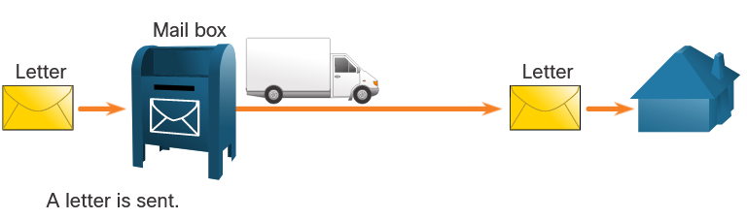
Network Layer Characteristics Connectionless
IP is Connectionless
IP does not establish a connection with the destination before sending the packet.
There is no control information needed (synchronizations, acknowledgments, etc.).
The destination will receive the packet when it arrives, but no pre-notifications are sent by IP.
If there is a need for connection-oriented traffic, then another protocol will handle this (typically TCP at the transport layer).
Notes:
8 – Network Layer
8.1 – Network Layer Characteristics
8.1.4 – Connectionless

Slide 74
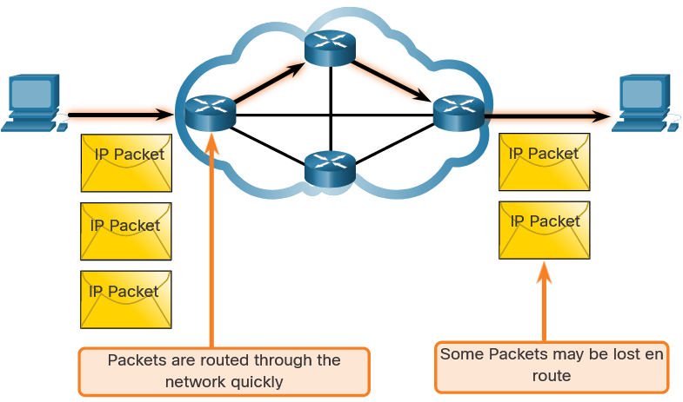
Network Layer Characteristics Best Effort
IP is Best Effort
IP will not guarantee delivery of the packet.
IP has reduced overhead since there is no mechanism to resend data that is not received.
IP does not expect acknowledgments.
IP does not know if the other device is operational or if it received the packet.
Notes:
8 – Network Layer
8.1 – Network Layer Characteristics
8.1.5 – Best Effort

Slide 75
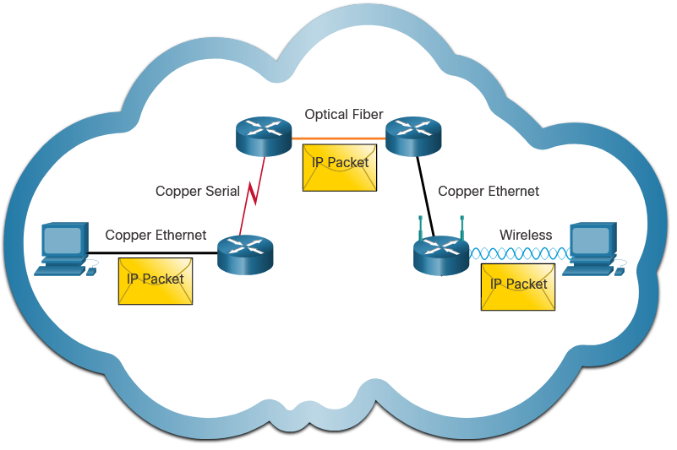
Network Layer Characteristics Media Independent
IP is unreliable:
It cannot manage or fix undelivered or corrupt packets.
IP cannot retransmit after an error.
IP cannot realign out of sequence packets.
IP must rely on other protocols for these functions.
IP is media Independent:
IP does not concern itself with the type of frame required at the data link layer or the media type at the physical layer.
IP can be sent over any media type: copper, fiber, or wireless.
Notes:
8 – Network Layer
8.1 – Network Layer Characteristics
8.1.6 – Media Independent
8.1.7 Check Your Understanding – IP Characteristics

Slide 76
Network Layer Characteristics Media Independent (Contd.)
The network layer will establish the Maximum Transmission Unit (MTU).
Network layer receives this from control information sent by the data link layer.
The network then establishes the MTU size.
Fragmentation is when Layer 3 splits the IPv4 packet into smaller units.
Fragmenting causes latency.
IPv6 does not fragment packets.
Example: Router goes from Ethernet to a slow WAN with a smaller MTU
Notes:
8 – Network Layer
8.1 – Network Layer Characteristics
8.1.6 – Media Independent
8.1.7 Check Your Understanding – IP Characteristics

Slide 77
8.2 IPv4 Packet
Notes:
8 – Network Layer
8.2 – IPv4 Packet

Slide 78
IPv4 Packet IPv4 Packet Header
IPv4 is the primary communication protocol for the network layer.
The network header has many purposes:
It ensures the packet is sent in the correct direction (to the destination).
It contains information for network layer processing in various fields.
The information in the header is used by all layer 3 devices that handle the packet
Notes:
8 – Network Layer
8.2 – IPv4 Packet
8.2.1 – IPv4 Packet Header

Slide 79
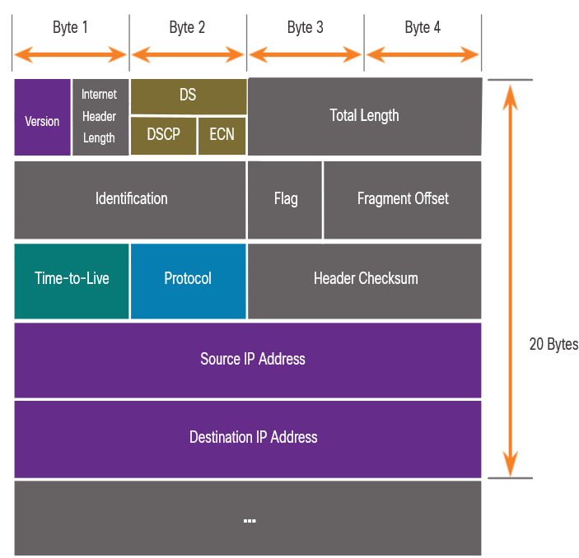
IPv4 Packet IPv4 Packet Header Fields
The IPv4 network header characteristics:
It is in binary.
Contains several fields of information
Diagram is read from left to right, 4 bytes per line
The two most important fields are the source and destination.
Protocols may have may have one or more functions.
Notes:
8 – Network Layer
8.2 – IPv4 Packet
8.2.2 – IPv4 Packet Header Fields

Slide 80
IPv4 Packet IPv4 Packet Header Fields
Significant fields in the IPv4 header:
Function | Description
Version | This will be for v4, as opposed to v6, a 4 bit field= 0100
Differentiated Services | Used for QoS: DiffServ – DS field or the older IntServ – ToS or Type of Service
Header Checksum | Detect corruption in the IPv4 header
Time to Live (TTL) | Layer 3 hop count. When it becomes zero the router will discard the packet.
Protocol | I.D.s next level protocol: ICMP, TCP, UDP, etc.
Source IPv4 Address | 32 bit source address
Destination IPV4 Address | 32 bit destination address
Notes:
8 – Network Layer
8.2 – IPv4 Packet
8.2.2 – IPv4 Packet Header Fields

Slide 81
8.3 IPv6 Packets
Notes:
8 – Network Layer
8.3 – IPv6 Packets

Slide 82
IPv6 Packets Limitations of IPv4
IPv4 has three major limitations:
IPv4 address depletion – We have basically run out of IPv4 addressing.
Lack of end-to-end connectivity – To make IPv4 survive this long, private addressing and NAT were created. This ended direct communications with public addressing.
Increased network complexity – NAT was meant as temporary solution and creates issues on the network as a side effect of manipulating the network headers addressing. NAT causes latency and troubleshooting issues.
Notes:
8 – Network Layer
8.3 – IPv6 Packets
8.3.1 – Limitations of IPv4

Slide 83
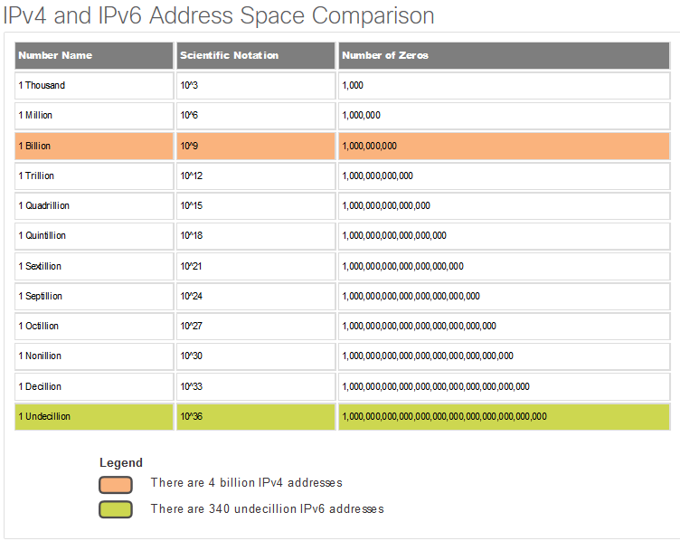
IPv6 Packets IPv6 Overview
IPv6 was developed by Internet Engineering Task Force (IETF).
IPv6 overcomes the limitations of IPv4.
Improvements that IPv6 provides:
Increased address space – based on 128 bit address, not 32 bits
Improved packet handling – simplified header with fewer fields
Eliminates the need for NAT – since there is a huge amount of addressing, there is no need to use private addressing internally and be mapped to a shared public address
Notes:
8 – Network Layer
8.3 – IPv6 Packets
8.3.2 – IPv6 Overview

Slide 84
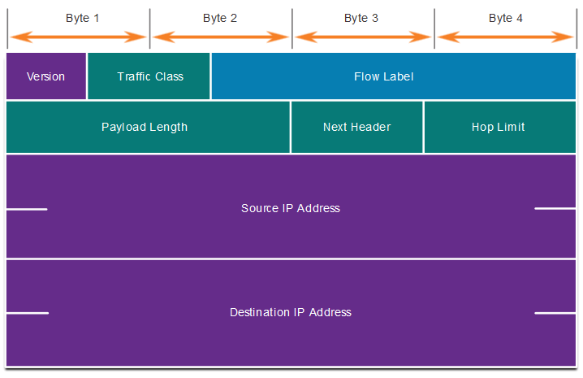
IPv6 Packets IPv4 Packet Header Fields in the IPv6 Packet Header
The IPv6 header is simplified, but not smaller.
The header is fixed at 40 Bytes or octets long.
Several IPv4 fields were removed to improve performance.
Some IPv4 fields were removed to improve performance:
Flag
Fragment Offset
Header Checksum
Notes:
8 – Network Layer
8.3 – IPv6 Packets
8.3.3 – IPv4 Packet Header Fields in the IPv6 Packet Header

Slide 85
IPv6 Packets IPv6 Packet Header
Significant fields in the IPv6 header:
Function | Description
Version | This will be for v6, as opposed to v4, a 4 bit field= 0110
Traffic Class | Used for QoS: Equivalent to DiffServ – DS field
Flow Label | Informs device to handle identical flow labels the same way, 20 bit field
Payload Length | This 16-bit field indicates the length of the data portion or payload of the IPv6 packet
Next Header | I.D.s next level protocol: ICMP, TCP, UDP, etc.
Hop Limit | Replaces TTL field Layer 3 hop count
Source IPv6 Address | 128 bit source address
Destination IPV6 Address | 128 bit destination address
Notes:
8 – Network Layer
8.3 – IPv6 Packets
8.3.4 – IPv6 Packet Header

Slide 86
IPv6 Packets IPv6 Packet Header (Cont.)
IPv6 packet may also contain extension headers (EH).
EH headers characteristics:
provide optional network layer information
are optional
are placed between IPv6 header and the payload
may be used for fragmentation, security, mobility support, etc.
Note: Unlike IPv4, routers do not fragment IPv6 packets.
Notes:
8 – Network Layer
8.3 – IPv6 Packets
8.3.4 – IPv6 Packet Header (Cont.)

Slide 87
8.4 How a Host Routes
Notes:
8 – Network Layer
8.4 – How a Host Routes

Slide 88
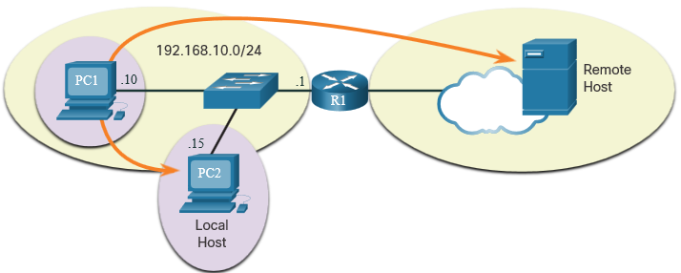
How a Host Routes Host Forwarding Decision
Packets are always created at the source.
Each host devices creates their own routing table.
A host can send packets to the following:
Itself – 127.0.0.1 (IPv4), ::1 (IPv6)
Local Hosts – destination is on the same LAN
Remote Hosts – devices are not on the same LAN
Notes:
8 – Network Layer
8.4 – How a Host Routes
8.4.1 – Host Forwarding Decision

Slide 89
How a Host Routes Host Forwarding Decision (Cont.)
The Source device determines whether the destination is local or remote
Method of determination:
IPv4 – Source uses its own IP address and Subnet mask, along with the destination IP address
IPv6 – Source uses the network address and prefix advertised by the local router
Local traffic is dumped out the host interface to be handled by an intermediary device.
Remote traffic is forwarded directly to the default gateway on the LAN.
Notes:
8 – Network Layer
8.4 – How a Host Routes
8.4.1 – Host Forwarding Decision (Cont.)

Slide 90
How a Host Routes Default Gateway
A router or layer 3 switch can be a default-gateway.
Features of a default gateway (DGW):
It must have an IP address in the same range as the rest of the LAN.
It can accept data from the LAN and is capable of forwarding traffic off of the LAN.
It can route to other networks.
If a device has no default gateway or a bad default gateway, its traffic will not be able to leave the LAN.
Notes:
8 – Network Layer
8.4 – How a Host Routes
8.4.2 – Default Gateway

Slide 91

How a Host Routes A Host Routes to the Default Gateway
The host will know the default gateway (DGW) either statically or through DHCP in IPv4.
IPv6 sends the DGW through a router solicitation (RS) or can be configured manually.
A DGW is static route which will be a last resort route in the routing table.
All device on the LAN will need the DGW of the router if they intend to send traffic remotely.
Notes:
8 – Network Layer
8.4 – How a Host Routes
8.4.3 – A Host Routes to the Default Gateway

Slide 92

How a Host Routes Host Routing Tables
On Windows, route print or netstat -r to display the PC routing table
Three sections displayed by these two commands:
Interface List – all potential interfaces and MAC addressing
IPv4 Routing Table
IPv6 Routing Table
Notes:
8 – Network Layer
8.4 – How a Host Routes
8.4.4 – Host Routing Tables
8.4.5 – Check Your Understanding – How a Host Routes

Slide 93
8.5 Introduction to Routing
Notes:
8 – Network Layer
8.5 – Introduction to Routing

Slide 94


Introduction to Routing Router Packet Forwarding Decision
What happens when the router receives the frame from the host device?
Notes:
8 – Network Layer
8.5 – Introduction to Routing
8.5.1 – Router Packet Forwarding Decision

Slide 95

Introduction to Routing IP Router Routing Table
There three types of routes in a router’s routing table:
Directly Connected – These routes are automatically added by the router, provided the interface is active and has addressing.
Remote – These are the routes the router does not have a direct connection and may be learned:
Manually – with a static route
Dynamically – by using a routing protocol to have the routers share their information with each other
Default Route – this forwards all traffic to a specific direction when there is not a match in the routing table
Notes:
8 – Network Layer
8.5 – Introduction to Routing
8.5.2 – IP Router Routing Table

Slide 96


Introduction to Routing Static Routing
Static Route Characteristics:
Must be configured manually
Must be adjusted manually by the administrator when there is a change in the topology
Good for small non-redundant networks
Often used in conjunction with a dynamic routing protocol for configuring a default route
Notes:
8 – Network Layer
8.5 – Introduction to Routing
8.5.3 – Static Routing

Slide 97


Introduction to Routing Dynamic Routing
Dynamic Routes Automatically:
Discover remote networks
Maintain up-to-date information
Choose the best path to the destination
Find new best paths when there is a topology change
Dynamic routing can also share static default routes with the other routers.
Notes:
8 – Network Layer
8.5 – Introduction to Routing
8.5.4 – Dynamic Routing

Slide 98

Introduction to Routing Introduction to an IPv4 Routing Table
The show ip route command shows the following route sources:
L - Directly connected local interface IP address
C – Directly connected network
S – Static route was manually configured by an administrator
O – OSPF
D – EIGRP
This command shows types of routes:
Directly Connected – C and L
Remote Routes – O, D, etc.
Default Routes – S*
Notes:
8 – Network Layer
8.5 – Introduction to Routing
8.5.6 – Introduction to an IPv4 Routing Table
8.5.7 – Check Your Understanding – Introduction to Routing

Slide 99
Module 4: Physical Layer
Introduction to Networks v7.0 (ITN)
Notes:
Cisco Networking Academy Program
Introduction to Networks v7.0 (ITN)
Module 4: Physical Layer

Slide 100
Module Objectives
Module Title: Physical Layer
Module Objective: Explain how physical layer protocols, services, and network media support communications across data networks.
Topic Title | Topic Objective
Purpose of the Physical Layer | Describe the purpose and functions of the physical layer in the network.
Physical Layer Characteristics | Describe characteristics of the physical layer.
Copper Cabling | Identify the basic characteristics of copper cabling.
UTP Cabling | Explain how UTP cable is used in Ethernet networks.
Fiber-Optic Cabling | Describe fiber optic cabling and its main advantages over other media.
Wireless Media | Connect devices using wired and wireless media.
Notes:
100
4- Physical Layer
4.0.2- What will I learn to do in this Module.

Slide 101
4.1 Purpose of the Physical Layer
Notes:
4- Physical Layer
4.1- Purpose of the Physical Layer

Slide 102
Purpose of the Physical Layer The Physical Connection
Before any network communications can occur, a physical connection to a local network must be established.
This connection could be wired or wireless, depending on the setup of the network.
This generally applies whether you are considering a corporate office or a home.
A Network Interface Card (NIC) connects a device to the network.
Some devices may have just one NIC, while others may have multiple NICs (Wired and/or Wireless, for example).
Not all physical connections offer the same level of performance.
Notes:
4 – Physical Layer
4.1 – Purpose of the Physical Layer
4.1.1 – The Physical Connection

Slide 103

Purpose of the Physical Layer The Physical Layer
Transports bits across the network media
Accepts a complete frame from the Data Link Layer and encodes it as a series of signals that are transmitted to the local media
This is the last step in the encapsulation process.
The next device in the path to the destination receives the bits and re-encapsulates the frame, then decides what to do with it.
Notes:
4 – Physical Layer
4.1 – Purpose of the Physical Layer
4.1.2 – The Physical Layer
4.1.3 – Check Your Understanding – Purpose of the Physical Layer

Slide 104
4.2 Physical Layer Characteristics
Notes:
4 - Physical Layer
4.2 - Physical Layer Characteristics

Slide 105

Physical Layer Characteristics Physical Layer Standards
Notes:
4 – Physical Layer
4.2 – Physical Layer Characteristics
4.2.1 – Physical Layer Standards

Slide 106
Physical Layer Characteristics Physical Components
Physical Layer Standards address three functional areas:
Physical Components
Encoding
Signaling
The Physical Components are the hardware devices, media, and other connectors that transmit the signals that represent the bits.
Hardware components like NICs, interfaces and connectors, cable materials, and cable designs are all specified in standards associated with the physical layer.
Notes:
4 – Physical Layer
4.2 – Physical Layer Characteristics
4.2.2 – Physical Components

Slide 107

Physical Layer Characteristics Encoding
Encoding converts the stream of bits into a format recognizable by the next device in the network path.
This ‘coding’ provides predictable patterns that can be recognized by the next device.
Examples of encoding methods include Manchester (shown in the figure), 4B/5B, and 8B/10B.
Notes:
4 – Physical Layer
4.2 – Physical Layer Characteristics
4.2.3 – Encoding

Slide 108



Physical Layer Characteristics Signaling
The signaling method is how the bit values, “1” and “0” are represented on the physical medium.
The method of signaling will vary based on the type of medium being used.
Light Pulses Over Fiber-Optic Cable
Electrical Signals Over Copper Cable
Microwave Signals Over Wireless
Notes:
4 – Physical Layer
4.2 – Physical Layer Characteristics
4.2.4 – Signaling

Slide 109
Physical Layer Characteristics Bandwidth
Bandwidth is the capacity at which a medium can carry data.
Digital bandwidth measures the amount of data that can flow from one place to another in a given amount of time; how many bits can be transmitted in a second.
Physical media properties, current technologies, and the laws of physics play a role in determining available bandwidth.
Unit of Bandwidth | Abbreviation | Equivalence
Bits per second | bps | 1 bps = fundamental unit of bandwidth
Kilobits per second | Kbps | 1 Kbps = 1,000 bps = 10³ bps
Megabits per second | Mbps | 1 Mbps = 1,000,000 bps = 10⁶ bps
Gigabits per second | Gbps | 1 Gbps – 1,000,000,000 bps = 10⁹ bps
Terabits per second | Tbps | 1 Tbps = 1,000,000,000,000 bps = 10¹² bps
Notes:
4 – Physical Layer
4.2 – Physical Layer Characteristics
4.2.5 – Bandwidth

Slide 110
Physical Layer Characteristics Bandwidth Terminology
Latency
Amount of time, including delays, for data to travel from one given point to another
Throughput
The measure of the transfer of bits across the media over a given period of time
Goodput
The measure of usable data transferred over a given period of time
Goodput = Throughput - traffic overhead
Notes:
4 – Physical Layer
4.2 – Physical Layer Characteristics
4.2.6 – Bandwidth Terminology
4.2.7 Check Your Understanding – Physical Layer Characteristics

Slide 111
4.3 Copper Cabling
Notes:
4 - Physical Layer
4.3 - Copper Cabling

Slide 112
Copper Cabling Characteristics of Copper Cabling
Copper cabling is the most common type of cabling used in networks today. It is inexpensive, easy to install, and has low resistance to electrical current flow.
Limitations:
Attenuation – the longer the electrical signals have to travel, the weaker they get.
The electrical signal is susceptible to interference from two sources, which can distort and corrupt the data signals (Electromagnetic Interference (EMI) and Radio Frequency Interference (RFI) and Crosstalk).
Mitigation:
Strict adherence to cable length limits will mitigate attenuation.
Some kinds of copper cable mitigate EMI and RFI by using metallic shielding and grounding.
Some kinds of copper cable mitigate crosstalk by twisting opposing circuit pair wires together.
Notes:
4 – Physical Layer
4.3 – Copper Cabling
4.3.1 – Characteristics of Copper Cabling

Slide 113

Copper Cabling Types of Copper Cabling
Notes:
4 – Physical Layer
4.3 – Copper Cabling
4.3.2 – Types of Copper Cabling

Slide 114

Copper Cabling Unshielded Twisted Pair (UTP)
UTP is the most common networking media.
Terminated with RJ-45 connectors
Interconnects hosts with intermediary network devices.
Key Characteristics of UTP
The outer jacket protects the copper wires from physical damage.
Twisted pairs protect the signal from interference.
Color-coded plastic insulation electrically isolates the wires from each other and identifies each pair.
Notes:
4 – Physical Layer
4.3 – Copper Cabling
4.3.3 – Unshielded Twisted Pair (UTP)

Slide 115

Copper Cabling Shielded Twisted Pair (STP)
Better noise protection than UTP
More expensive than UTP
Harder to install than UTP
Terminated with RJ-45 connectors
Interconnects hosts with intermediary network devices
Key Characteristics of STP
The outer jacket protects the copper wires from physical damage
Braided or foil shield provides EMI/RFI protection
Foil shield for each pair of wires provides EMI/RFI protection
Color-coded plastic insulation electrically isolates the wires from each other and identifies each pair
Notes:
4 – Physical Layer
4.3 – Copper Cabling
4.3.4 – Shielded Twisted Pair (STP)

Slide 116


Copper Cabling Coaxial Cable
Consists of the following:
Outer cable jacket to prevent minor physical damage
A woven copper braid, or metallic foil, acts as the second wire in the circuit and as a shield for the inner conductor.
A layer of flexible plastic insulation
A copper conductor is used to transmit the electronic signals.
There are different types of connectors used with coax cable.
Commonly used in the following situations:
Wireless installations - attach antennas to wireless devices
Cable internet installations - customer premises wiring
Notes:
4 – Physical Layer
4.3 – Copper Cabling
4.3.5 – Coaxial Cable
4.3.6 Check Your Understanding – Copper Cabling

Slide 117
4.4 UTP Cabling
Notes:
4 -Physical Layer
4.4 - UTP cabling

Slide 118

UTP Cabling Properties of UTP Cabling
UTP has four pairs of color-coded copper wires twisted together and encased in a flexible plastic sheath. No shielding is used. UTP relies on the following properties to limit crosstalk:
Cancellation - Each wire in a pair of wires uses opposite polarity. One wire is negative, the other wire is positive. They are twisted together and the magnetic fields effectively cancel each other and outside EMI/RFI.
Variation in twists per foot in each wire - Each wire is twisted a different amount, which helps prevent crosstalk amongst the wires in the cable.
Notes:
4 – Physical Layer
4.4 – UTP Cabling
4.4.1 – Properties of UTP Cabling

Slide 119

UTP Cabling UTP Cabling Standards and Connectors
Standards for UTP are established by the TIA/EIA. TIA/EIA-568 standardizes elements like:
Cable Types
Cable Lengths
Connectors
Cable Termination
Testing Methods
Electrical standards for copper cabling are established by the IEEE, which rates cable according to its performance. Examples include:
Category 3
Category 5 and 5e
Category 6
Notes:
4 – Physical Layer
4.4 – UTP Cabling
4.4.2 - UTP Cabling Standards and Connectors

Slide 120






UTP Cabling UTP Cabling Standards and Connectors (Cont.)
RJ-45 Connector
Poorly terminated UTP cable
Properly terminated UTP cable
RJ-45 Socket
Notes:
4 – Physical Layer
4.4 – UTP Cabling
4.4.2 – UTP Cabling Standards and Connectors

Slide 121

UTP Cabling Straight-through and Crossover UTP Cables
Cable Type | Standard | Application
Ethernet Straight-through | Both ends T568A or T568B | Host to Network Device
Ethernet Crossover * | One end T568A, other end T568B | Host-to-Host, Switch-to-Switch, Router-to-Router
* Considered Legacy due to most NICs using Auto-MDIX to sense cable type and complete connection
Rollover | Cisco Proprietary | Host serial port to Router or Switch Console Port, using an adapter
Notes:
4 – Physical Layer
4.4 – UTP Cabling
4.4.3 – Straight-through and Crossover UTP Cables
4.4.4 – Activity – Cable Pinouts

Slide 122
4.5 Fiber-Optic Cabling
Notes:
4- Physical Layer
4.5 - Fiber-Optic Cabling

Slide 123
Fiber-Optic Cabling Properties of Fiber-Optic Cabling
Not as common as UTP because of the expense involved
Ideal for some networking scenarios
Transmits data over longer distances at higher bandwidth than any other networking media
Less susceptible to attenuation, and completely immune to EMI/RFI
Made of flexible, extremely thin strands of very pure glass
Uses a laser or LED to encode bits as pulses of light
The fiber-optic cable acts as a wave guide to transmit light between the two ends with minimal signal loss
Notes:
4 – Physical Layer
4.5 – Fiber-Optic Cabling
4.5.1 – Properties of Fiber-Optic Cabling

Slide 124


Fiber-Optic Cabling Types of Fiber Media
Single-Mode Fiber
Multimode Fiber
Very small core
Uses expensive lasers
Long-distance applications
Larger core
Uses less expensive LEDs
LEDs transmit at different angles
Up to 10 Gbps over 550 meters
Dispersion refers to the spreading out of a light pulse over time. Increased dispersion means increased loss of signal strength. MMF has greater dispersion than SMF, with a the maximum cable distance for MMF is 550 meters.
Notes:
4 – Physical Layer
4.5 – Fiber-Optic Cabling
4.5.2 – Types of Fiber Media

Slide 125
Fiber-Optic Cabling Fiber-Optic Cabling Usage
Fiber-optic cabling is now being used in four types of industry:
Enterprise Networks - Used for backbone cabling applications and interconnecting infrastructure devices
Fiber-to-the-Home (FTTH) - Used to provide always-on broadband services to homes and small businesses
Long-Haul Networks - Used by service providers to connect countries and cities
Submarine Cable Networks - Used to provide reliable high-speed, high-capacity solutions capable of surviving in harsh undersea environments at up to transoceanic distances.
Our focus in this course is the use of fiber within the enterprise.
Notes:
4 – Physical Layer
4.5 – Fiber-Optic Cabling
4.5.3 – Fiber-Optic Cabling Usage

Slide 126




Fiber-Optic Cabling Fiber-Optic Connectors
Straight-Tip (ST) Connectors
Lucent Connector (LC) Simplex Connectors
Subscriber Connector (SC) Connectors
Duplex Multimode LC Connectors
Notes:
4 – Physical Layer
4.5 – Fiber-Optic Cabling
4.5.4 – Fiber-Optic Connectors

Slide 127




Fiber-Optic Cabling Fiber Patch Cords
SC-SC MM Patch Cord
LC-LC SM Patch Cord
ST-LC MM Patch Cord
ST-SC SM Patch Cord
A yellow jacket is for single-mode fiber cables and orange (or aqua) for multimode fiber cables.
Notes:
4 – Physical Layer
4.5 – Fiber-Optic Cabling
4.5.5 - Fiber Patch Cords

Slide 128
Fiber-Optic Cabling Fiber versus Copper
Optical fiber is primarily used as backbone cabling for high-traffic, point-to-point
connections between data distribution facilities and for the interconnection of buildings
in multi-building campuses.
Implementation Issues | UTP Cabling | Fiber-Optic Cabling
Bandwidth supported | 10 Mb/s - 10 Gb/s | 10 Mb/s - 100 Gb/s
Distance | Relatively short (1 - 100 meters) | Relatively long ( 1 - 100,000 meters)
Immunity to EMI and RFI | Low | High (Completely immune)
Immunity to electrical hazards | Low | High (Completely immune)
Media and connector costs | Lowest | Highest
Installation skills required | Lowest | Highest
Safety precautions | Lowest | Highest
Notes:
4 – Physical Layer
4.5 – Fiber-Optic Cabling
4.5.6 – Fiber versus Copper
4.5.7 – Check Your Understanding – Fiber-Optic Cabling

Slide 129
4.6 Wireless Media
Notes:
4 - Physical Layer
4.6 - Wireless Media

Slide 130
Wireless Media Properties of Wireless Media
It carries electromagnetic signals representing binary digits using radio or microwave frequencies. This provides the greatest mobility option. Wireless connection numbers continue to increase.
Some of the limitations of wireless:
Coverage area - Effective coverage can be significantly impacted by the physical characteristics of the deployment location.
Interference - Wireless is susceptible to interference and can be disrupted by many common devices.
Security - Wireless communication coverage requires no access to a physical strand of media, so anyone can gain access to the transmission.
Shared medium - WLANs operate in half-duplex, which means only one device can send or receive at a time. Many users accessing the WLAN simultaneously results in reduced bandwidth for each user.
Notes:
4 – Physical Layer
4.6 – Wireless Media
4.6.1 – Properties of Wireless Media

Slide 131
Wireless Media Types of Wireless Media
The IEEE and telecommunications industry standards for wireless data communications
cover both the data link and physical layers. In each of these standards, physical layer
specifications dictate:
Data to radio signal encoding methods
Frequency and power of transmission
Signal reception and decoding requirements
Antenna design and construction
Wireless Standards:
Wi-Fi (IEEE 802.11) - Wireless LAN (WLAN) technology
Bluetooth (IEEE 802.15) - Wireless Personal Area network (WPAN) standard
WiMAX (IEEE 802.16) - Uses a point-to-multipoint topology to provide broadband wireless access
Zigbee (IEEE 802.15.4) - Low data-rate, low power-consumption communications, primarily for Internet of Things (IoT) applications
Notes:
4 – Physical Layer
4.6 – Wireless Media
4.6.2 - Types of Wireless Media

Slide 132
Wireless Media Wireless LAN
In general, a Wireless LAN (WLAN) requires the following devices:
Wireless Access Point (AP) - Concentrate wireless signals from users and connect to the existing copper-based network infrastructure
Wireless NIC Adapters - Provide wireless communications capability to network hosts
There are a number of WLAN standards. When purchasing WLAN equipment, ensure compatibility, and interoperability.
Network Administrators must develop and apply stringent security policies and processes to protect WLANs from unauthorized access and damage.
Notes:
4 – Physical Layer
4.6 – Wireless Media
4.6.3 – Wireless LAN
4.6.4 – Check Your Understanding – Wireless Media

Slide 133
10.2 Device Discovery with LLDP
Notes:
10 - Network Management
10.2 - Device Discovery with LLDP

Slide 134

Device Discovery with LLDP LLDP Overview
Link Layer Discovery Protocol (LLDP) is a vendor-neutral neighbor discovery protocol similar to CDP. LLDP works with network devices, such as routers, switches, and wireless LAN access points. This protocol advertises its identity and capabilities to other devices and receives the information from a physically-connected Layer 2 device.
Notes:
10 - Network Management
10.2 - Device Discovery with LLDP
10.2.1 - LLDP Overview

Slide 135
Device Discovery with LLDP Configure and Verify LLDP
LLDP may be enabled by default. To enable LLDP globally on a Cisco network device, enter the lldp run command in the global config mode. To disable LLDP, enter the no lldp run command in the global config mode.
LLDP can be configured on specific interfaces. However, LLDP must be configured separately to transmit and receive LLDP packets.
To verify LLDP is enabled, enter the show lldp command in privileged EXEC mode.
Switch# conf t
Enter configuration commands, one per line. End with CNTL/Z.
Switch(config)# lldp run
Switch(config)# interface gigabitethernet 0/1
Switch(config-if)# lldp transmit
Switch(config-if)# lldp receive
Switch(config-if)# end
Switch# show lldp
Global LLDP Information:
Status: ACTIVE
LLDP advertisements are sent every 30 seconds
LLDP hold time advertised is 120 seconds
LLDP interface reinitialisation delay is 2 seconds
Notes:
10 - Network Management
10.2 - Device Discovery with LLDP
10.2.2 - Configure and Verify LLDP

Slide 136
Device Discovery with LLDP Discover Devices by Using LLDP
With LLDP enabled, device neighbors can be discovered by using the show lldp neighbors command.
S1# show lldp neighbors
Capability codes:
(R) Router, (B) Bridge, (T) Telephone, (C) DOCSIS Cable Device
(W) WLAN Access Point, (P) Repeater, (S) Station, (O) Other
Device ID Local Intf Hold-time Capability Port ID
R1 Fa0/5 117 R Gi0/0/1
S2 Fa0/1 112 B Fa0/1
Total entries displayed: 2
Notes:
10 - Network Management
10.2 - Device Discovery with LLDP
10.2.3 - Discover Devices by Using LLDP

Slide 137
Device Discovery with LLDP Discover Devices by Using LLDP (Cont.)
When more details about the neighbors are needed, the show lldp neighbors detail command can provide information, such as the neighbor IOS version, IP address, and device capability.
S1# show lldp neighbors detail
------------------------------------------------
Chassis id: 848a.8d44.49b0
Port id: Gi0/0/1
Port Description: GigabitEthernet0/0/1
System Name: R1
System Description: Cisco IOS Software [Fuji], ISR Software (X86_64_LINUX_.....,
RELEASE SOFTWARE (fc2)
Technical Support: http://www.cisco.com/techsupport
Copyright (c) 1986-2019 by Cisco Systems, Inc.
Compiled Thu 22-Aug-19 18:09 by mcpre
Time remaining: 111 seconds
System Capabilities: B,R
Enabled Capabilities: R
Management Addresses - not advertised
(output omitted)
Notes:
10 - Network Management
10.2 - Device Discovery with LLDP
10.2.3 - Discover Devices by Using LLDP (Cont.)
10.2.4 - Syntax Checker - Configure and Verify LLDP
10.2.5 - Check Your Understanding - Compare CDP and LLDP

Slide 138
10.4 SNMP
Notes:
10 - Network Management
10.4 - SNMP

Slide 139
SNMP Introduction to SNMP
SNMP was developed to allow administrators to manage nodes on an IP network. It enables network administrators to monitor and manage network performance, find and solve network problems, and plan for network growth.
SNMP is an application layer protocol that provides a message format for communication between managers and agents. The SNMP system consists of three elements:
SNMP manager
SNMP agents (managed node)
Management Information Base (MIB)
SNMP defines how management information is exchanged between network management applications and management agents. The SNMP manager polls the agents and queries the MIB for SNMP agents on UDP port 161. SNMP agents send any SNMP traps to the SNMP manager on UDP port 162.
Notes:
10 - Network Management
10.4 - SNMP
10.4.1 - Introduction to SNMP

Slide 140

SNMP Introduction to SNMP (Cont.)
The SNMP manager is part of a network management system (NMS). The SNMP manager can collect information from an SNMP agent by using the “get” action and can change configurations on an agent by using the “set” action. SNMP agents can forward information directly to a network manager by using “traps”.
The SNMP agent and MIB reside on SNMP client devices. MIBs store data about the device and operational statistics and are meant to be available to authenticated remote users. The SNMP agent is responsible for providing access to the local MIB.
Notes:
10 - Network Management
10.4 - SNMP
10.4.1 - Introduction to SNMP (Cont.)

Slide 141
SNMP SNMP Operation
SNMP agents that reside on managed devices collect and store information about the device and its operation locally in the MIB. The SNMP manager then uses the SNMP agent to access information within the MIB.
There are two primary SNMP manager requests, get and set. In addition to configuration, a set can cause an action to occur, like restarting a router.
Operation | Description
get-request | Retrieves a value from a specific variable.
get-next-request | Retrieves a value from a variable within a table; the SNMP manager does not need to know the exact variable name. A sequential search is performed to find the needed variable from within a table.
get-bulk-request | Retrieves large blocks of data, such as multiple rows in a table, that would otherwise require the transmission of many small blocks of data. (Only works with SNMPv2 or later.)
get-response | Replies to a get-request, get-next-request, and set-request sent by an NMS.
set-request | Stores a value in a specific variable.
Notes:
10 - Network Management
10.4 - SNMP
10.4.2 - SNMP Operation

Slide 142

SNMP SNMP Operation (Cont.)
The SNMP agent responds to SNMP manager requests as follows:
Get an MIB variable - The SNMP agent performs this function in response to a GetRequest-PDU from the network manager. The agent retrieves the value of the requested MIB variable and responds to the network manager with that value.
Set an MIB variable - The SNMP agent performs this function in response to a SetRequest-PDU from the network manager. The SNMP agent changes the value of the MIB variable to the value specified by the network manager. An SNMP agent reply to a set request includes the new settings in the device.
Notes:
10 - Network Management
10.4 - SNMP
10.4.2 - SNMP Operation (Cont.)

Slide 143

SNMP SNMP Agent Traps
Traps are unsolicited messages alerting the SNMP manager to a condition or event on the network. Trap-directed notifications reduce network and agent resources by eliminating the need for some of SNMP polling requests.
The figure illustrates the use of an SNMP trap to alert the network administrator that interface G0/0/0 has failed. The NMS software can send the network administrator a text message, pop up a window on the NMS software, or turn the router icon red in the NMS GUI.
Notes:
10 - Network Management
10.4 - SNMP
10.4.3 - SNMP Agent Traps

Slide 144
SNMP SNMP Versions
SNMPv1 - Legacy standard defined in RFC 1157. Uses a simple community-string based authentication method. Should not be used due to security risks.
SNMPv2c - Defined in RFCs 1901-1908. Uses a simple community-string based authentication method. Provides for bulk retrieval options, as well as more detailed error messages.
SNMPv3 - Defined in RFCs 3410-3415. Uses username authentication, provides data protection using HMAC-MD5 or HMAC-SHA and encryption using DES, 3DES, or AES encryption.
Notes:
10 - Network Management
10.4 - SNMP
10.4.4 - SNMP Versions
10.4.5 - Check Your Understanding - SNMP Versions

Slide 145
SNMP Community Strings
SNMPv1 and SNMPv2c use community strings that control access to the MIB. Community strings are plaintext passwords. SNMP community strings authenticate access to MIB objects.
There are two types of community strings:
Read-only (ro) - This type provides access to the MIB variables, but does not allow these variables to be changed, only read. Because security is minimal in version 2c, many organizations use SNMPv2c in read-only mode.
Read-write (rw) - This type provides read and write access to all objects in the MIB.
To view or set MIB variables, the user must specify the appropriate community string for read or write access.
Notes:
10 - Network Management
10.4 - SNMP
10.4.6 - Community Strings

Slide 146
SNMP MIB Object ID
The MIB organizes variables hierarchically. Formally, the MIB defines each variable as an object ID (OID). OIDs uniquely identify managed objects. The MIB organizes the OIDs based on RFC standards into a hierarchy of OIDs, usually shown as a tree.
The MIB tree for any given device includes some branches with variables common to many networking devices and some branches with variables specific to that device or vendor.
RFCs define some common public variables. Most devices implement these MIB variables. In addition, networking equipment vendors, like Cisco, can define their own private branches of the tree to accommodate new variables specific to their devices.
Notes:
10 - Network Management
10.4 - SNMP
10.4.7 - MIB Object ID

Slide 147

SNMP MIB Object ID (Cont.)
The figure shows portions of the MIB structure defined by Cisco. Note how the OID can be described in words or numbers to help locate a particular variable in the tree.
OIDs belonging to Cisco, are numbered as follows: .iso (1).org (3).dod (6).internet (1).private (4).enterprises (1).cisco (9).
Therefore, the OID is 1.3.6.1.4.1.9.
Notes:
10 - Network Management
10.4 - SNMP
10.4.7 - MIB Object ID (Cont.)

Slide 148

SNMP SNMP Polling Scenario
SNMP can be used is to observe CPU utilization over a period of time by polling devices. CPU statistics can then be compiled on the NMS and graphed. This creates a baseline for the network administrator.
The data is retrieved via the snmpget utility, issued on the NMS. Using the snmpget utility, you can manually retrieve real-time data, or have the NMS run a report. This report would give you a period of time that you could use the data to get the average.
Notes:
10 - Network Management
10.4 - SNMP
10.4.8 - SNMP Polling Scenario

Slide 149

SNMP SNMP Object Navigator
The snmpget utility gives some insight into the basic mechanics of how SNMP works. However, working with long MIB variable names like 1.3.6.1.4.1.9.2.1.58.0 can be problematic for the average user. More commonly, the network operations staff uses a network management product with an easy-to-use GUI, which makes the entire MIB data variable naming transparent to the user.
The Cisco SNMP Navigator on the http://www.cisco.com website allows a network administrator to research details about a particular OID.
Notes:
10 - Network Management
10.4 - SNMP
10.4.9 - SNMP Object Navigator

Slide 150
10.5 Syslog
Notes:
10 - Network Management
10.5 - Syslog

Slide 151

Syslog Introduction to Syslog
Syslog uses UDP port 514 to send event notification messages across IP networks to event message collectors, as shown in the figure.
The syslog logging service provides three primary functions, as follows:
The ability to gather logging information for monitoring and troubleshooting
The ability to select the type of logging information that is captured
The ability to specify the destinations of captured syslog messages
Notes:
10 - Network Management
10.5 - Syslog
10.5.1 - Introduction to Syslog

Slide 152
Syslog Syslog Operation
The syslog protocol starts by sending system messages and debug output to a local logging process. Syslog configuration may send these messages across the network to an external syslog server, where they can be retrieved without needing to access the actual device.
Alternatively, syslog messages may be sent to an internal buffer. Messages sent to the internal buffer are only viewable through the CLI of the device.
The network administrator may specify that only certain types of system messages be sent to various destinations. Popular destinations for syslog messages include the following:
Logging buffer (RAM inside a router or switch)
Console line
Terminal line
Syslog server
Notes:
10 - Network Management
10.5 - Syslog
10.5.2 - Syslog Operation

Slide 153
Syslog Syslog Message Format
Cisco devices produce syslog messages as a result of network events. Every syslog message contains a severity level and a facility.
The smaller numerical levels are the more critical syslog alarms. The severity level of the messages can be set to control where each type of message is displayed (i.e. on the console or the other destinations). The complete list of syslog levels is shown in the table.
Severity Name | Severity Level | Explanation
Emergency | Level 0 | System Unusable
Alert | Level 1 | Immediate Action Needed
Critical | Level 2 | Critical Condition
Error | Level 3 | Error Condition
Warning | Level 4 | Warning Condition
Notification | Level 5 | Normal, but Significant Condition
Informational | Level 6 | Informational Message
Debugging | Level 7 | Debugging Message
Notes:
10 - Network Management
10.5 - Syslog
10.5.3 - Syslog Message Format

Slide 154
Syslog Syslog Facilities
In addition to specifying the severity, syslog messages also contain information on the facility. Syslog facilities are service identifiers that identify and categorize system state data for error and event message reporting. The logging facility options that are available are specific to the networking device.
Some common syslog message facilities reported on Cisco IOS routers include:
IP
OSPF protocol
SYS operating system
IP security (IPsec)
Interface IP (IF)
Notes:
10 - Network Management
10.5 - Syslog
10.5.4 - Syslog Facilities

Slide 155
Syslog Syslog Facilities (Cont.)
By default, the format of syslog messages on the Cisco IOS Software is as follows:
%facility-severity-MNEMONIC: description
For example, sample output on a Cisco switch for an EtherChannel link changing state to up is:
%LINK-3-UPDOWN: Interface Port-channel1, changed state to up
Here the facility is LINK and the severity level is 3, with a MNEMONIC of UPDOWN.
Notes:
10 - Network Management
10.5 - Syslog
10.5.4 - Syslog Facilities (Cont.)

Slide 156
Syslog Configure Syslog Timestamp
By default, log messages are not timestamped. Log messages should be timestamped so that when they are sent to another destination, such as a Syslog server, there is record of when the message was generated. Use the command service timestamps log datetime to force logged events to display the date and time.
R1# configure terminal
R1(config)# interface g0/0/0
R1(config-if)# shutdown
%LINK-5-CHANGED: Interface GigabitEthernet0/0/0, changed state to administratively down
%LINEPROTO-5-UPDOWN: Line protocol on Interface GigabitEthernet0/0/0, changed state to down R1(config-if)# exit
R1(config)# service timestamps log datetime
R1(config)# interface g0/0/0
R1(config-if)# no shutdown
*Mar 1 11:52:42: %LINK-3-UPDOWN: Interface GigabitEthernet0/0/0, changed state to down
*Mar 1 11:52:45: %LINK-3-UPDOWN: Interface GigabitEthernet0/0/0, changed state to up
*Mar 1 11:52:46: %LINEPROTO-5-UPDOWN: Line protocol on Interface GigabitEthernet0/0/0, changed state to up
R1(config-if)#
Notes:
10 - Network Management
10.5 - Syslog
10.5.5 - Configure Syslog Timestamp
10.5.6 - Check Your Understanding - Syslog Operation

